Slide 1
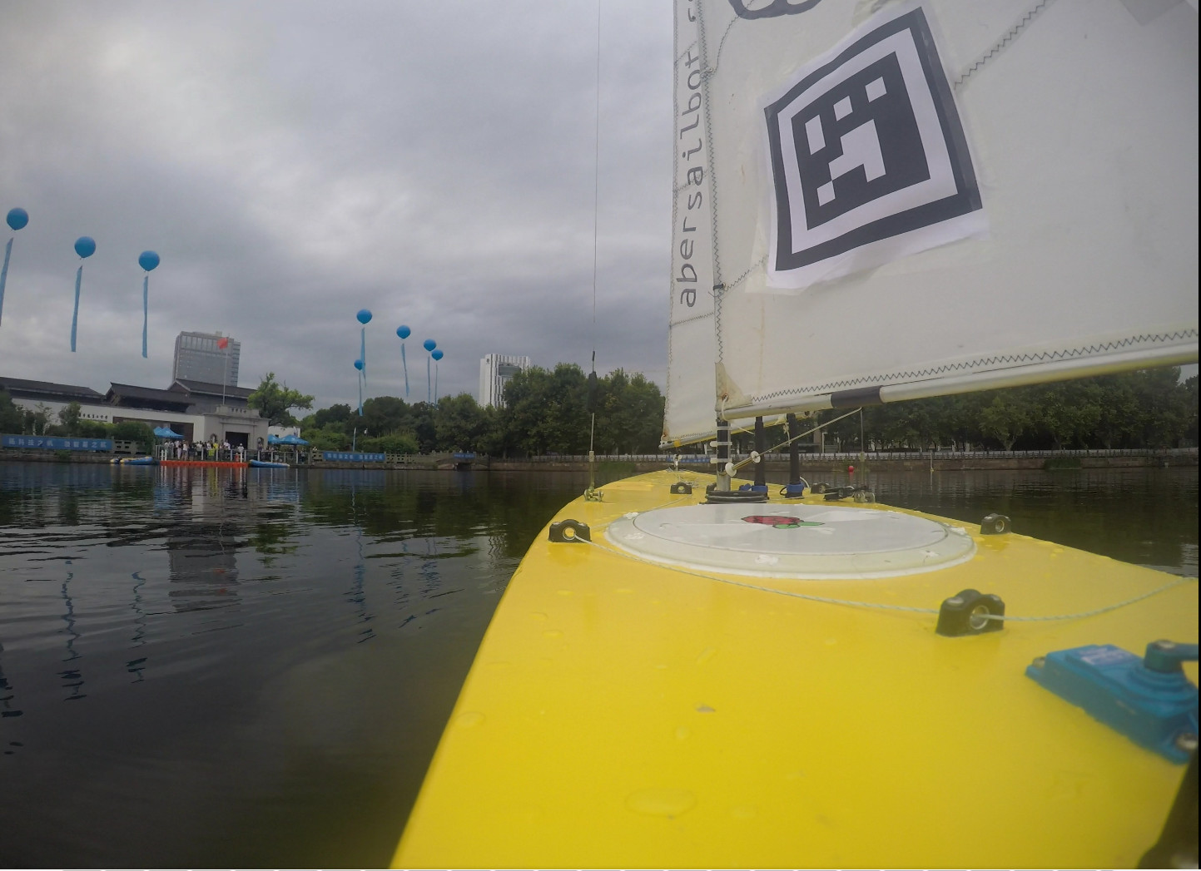

Notes:
---Lizzie---
Introduction

Slide 2
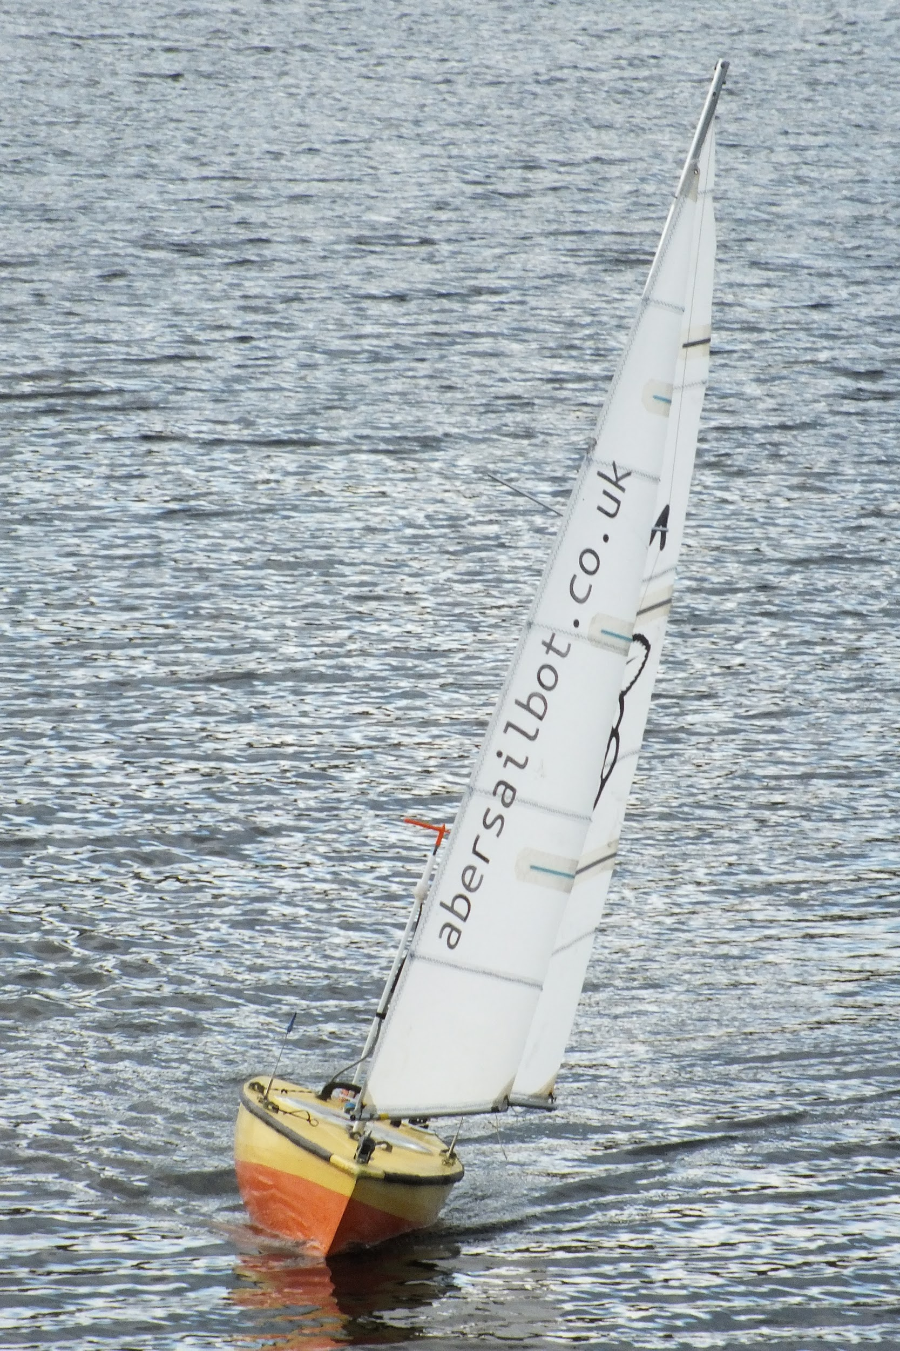



What do we do?
Build Autonomous Robotic Sailing Boats
Write code
Go to competitions
Public Engagement
fb.com/abersailbot @abersailbot sailbot@aber.ac.uk
Notes:
Robotic Boats
RC and Sail Themselves
Code (boatd etc)
Competitions
Microtransat
Not alone - community of people

Slide 3
How we work
Not a union society
Discord for communications
Real names would be really helpful!
Github for code
Weekly Skills sessions this term
Mix of online and in person
When is best? Poll at the end
fb.com/abersailbot @abersailbot sailbot@aber.ac.uk
Notes:
Robotic Boats
RC and Sail Themselves
Code (boatd etc)
Competitions
Microtransat
Not alone - community of people

Slide 4
How to make the most of it
Move fast and get things wet
Learn stuff
Faster than your course will teach you
A few hours per week time commitment
“Do-ocracy”
fb.com/abersailbot @abersailbot sailbot@aber.ac.uk
Notes:
Robotic Boats
RC and Sail Themselves
Code (boatd etc)
Competitions
Microtransat
Not alone - community of people

Slide 5
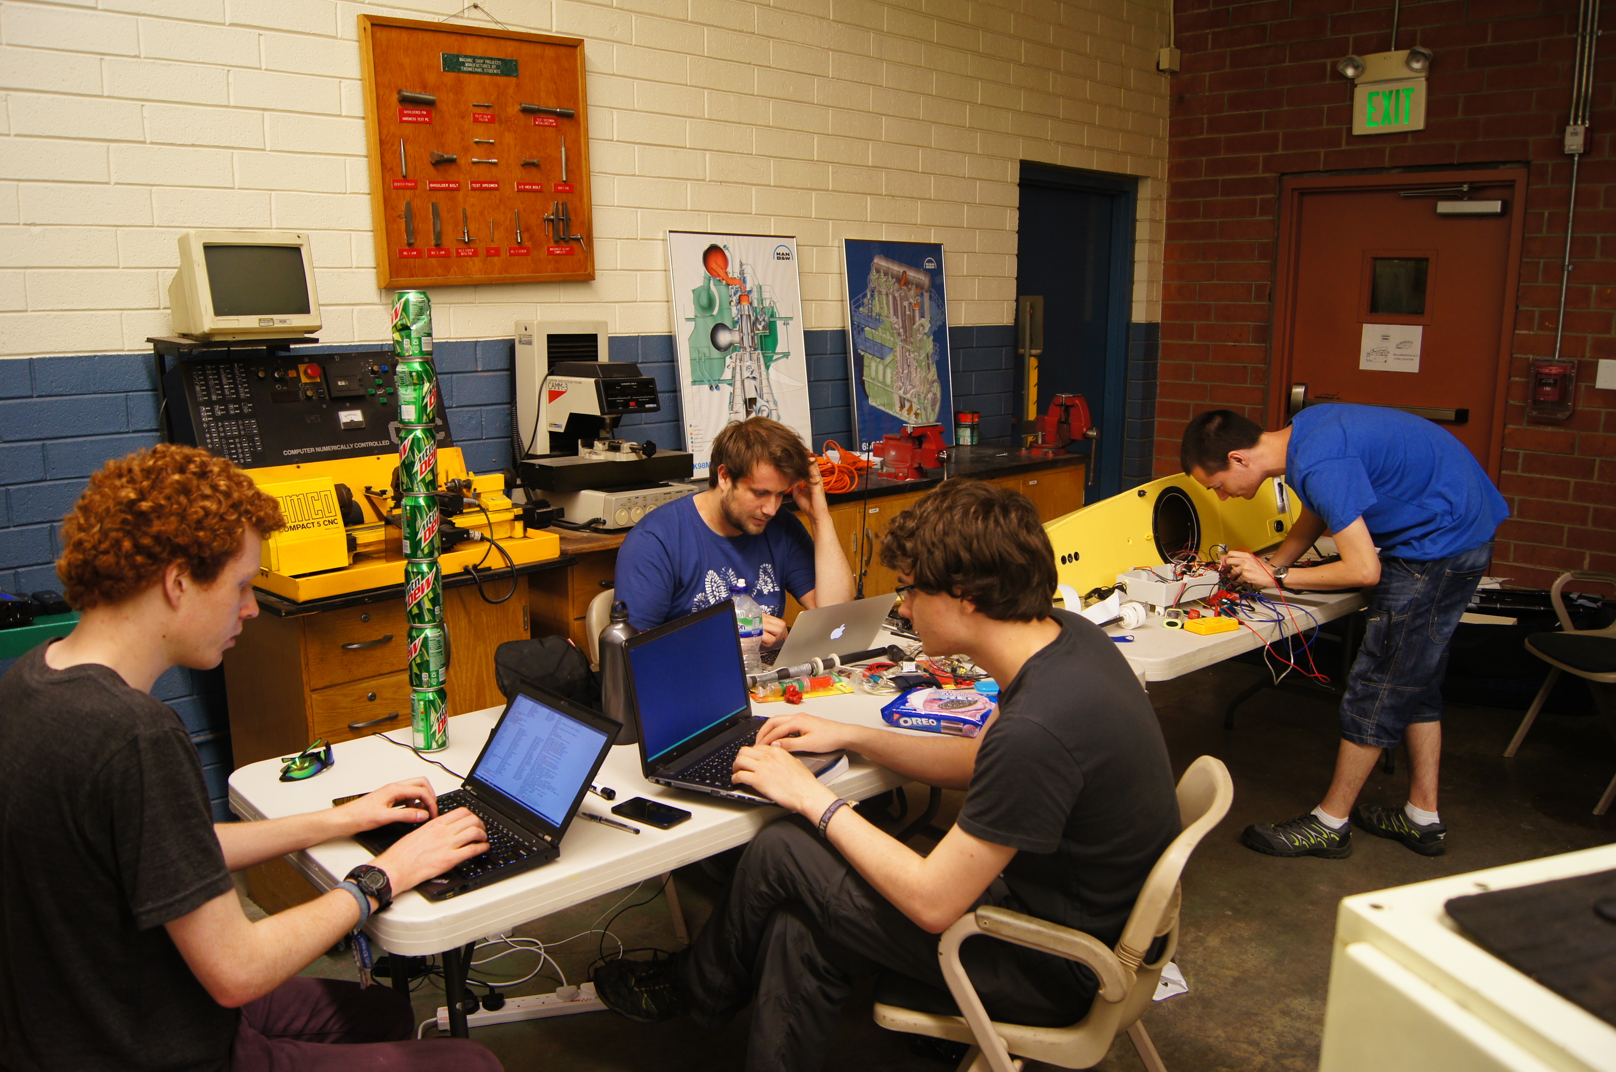
Technical skills you’ll gain
Interdisciplinary Technical skills
Coding, Linux, soldering, boat rigging, open source, integration
Computer Sci + Electronics + Naval Arch + Mechanical Eng + Oceanography
fb.com/abersailbot @abersailbot sailbot@aber.ac.uk
Notes:
Robotic Boats
RC and Sail Themselves
Code (boatd etc)
Competitions
Microtransat
Not alone - community of people

Slide 6
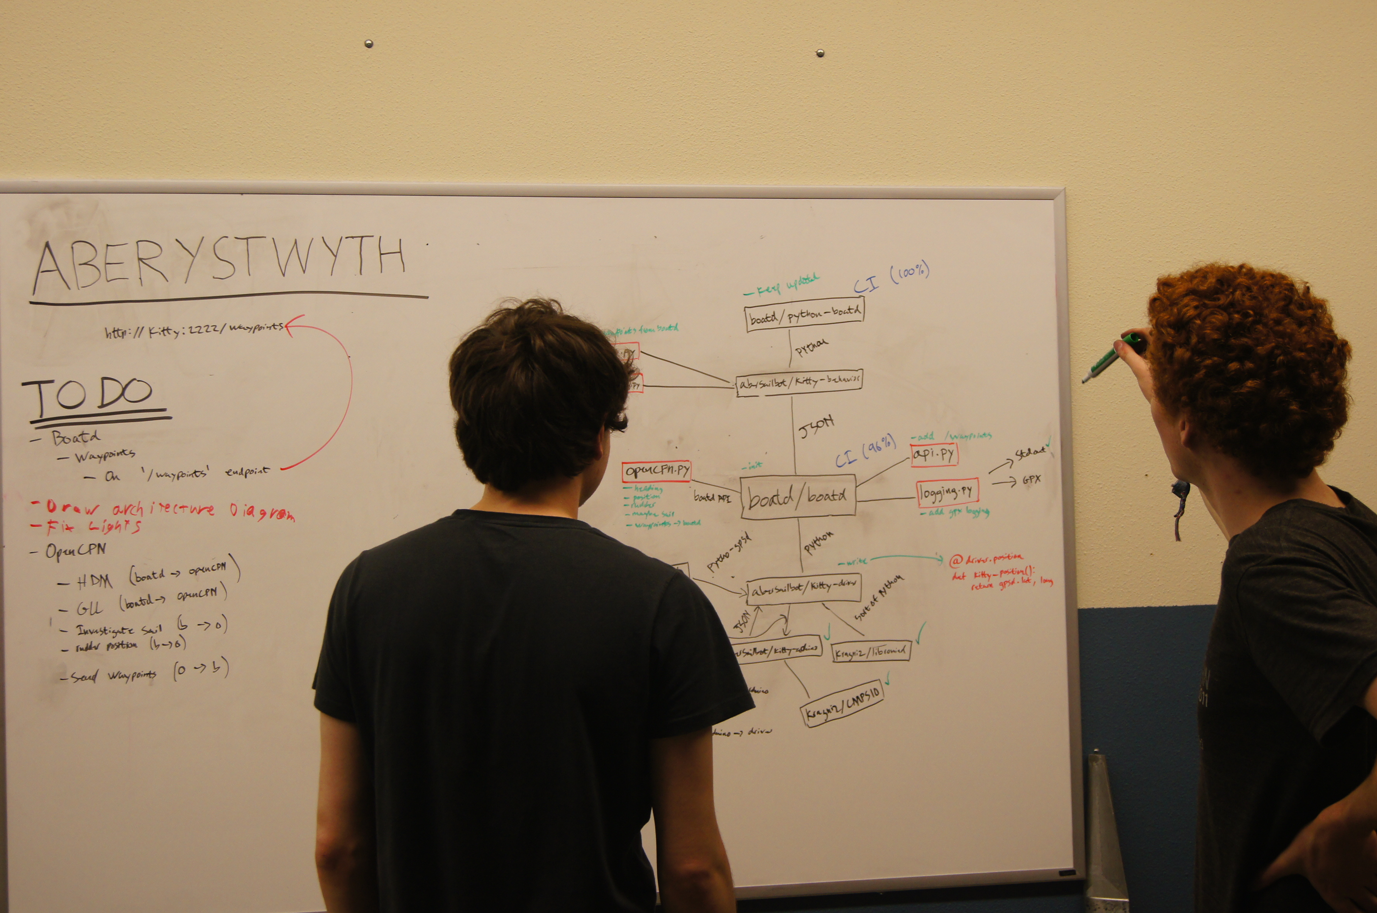
“soft” skills you’ll gain
Team working
Self learning
Project management
Online collaboration
Logistics
Fund Raising
fb.com/abersailbot @abersailbot sailbot@aber.ac.uk
Notes:
Robotic Boats
RC and Sail Themselves
Code (boatd etc)
Competitions
Microtransat
Not alone - community of people

Slide 7
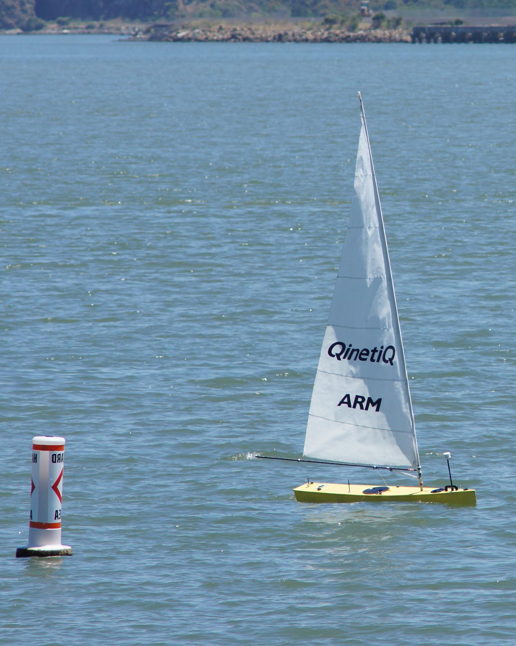
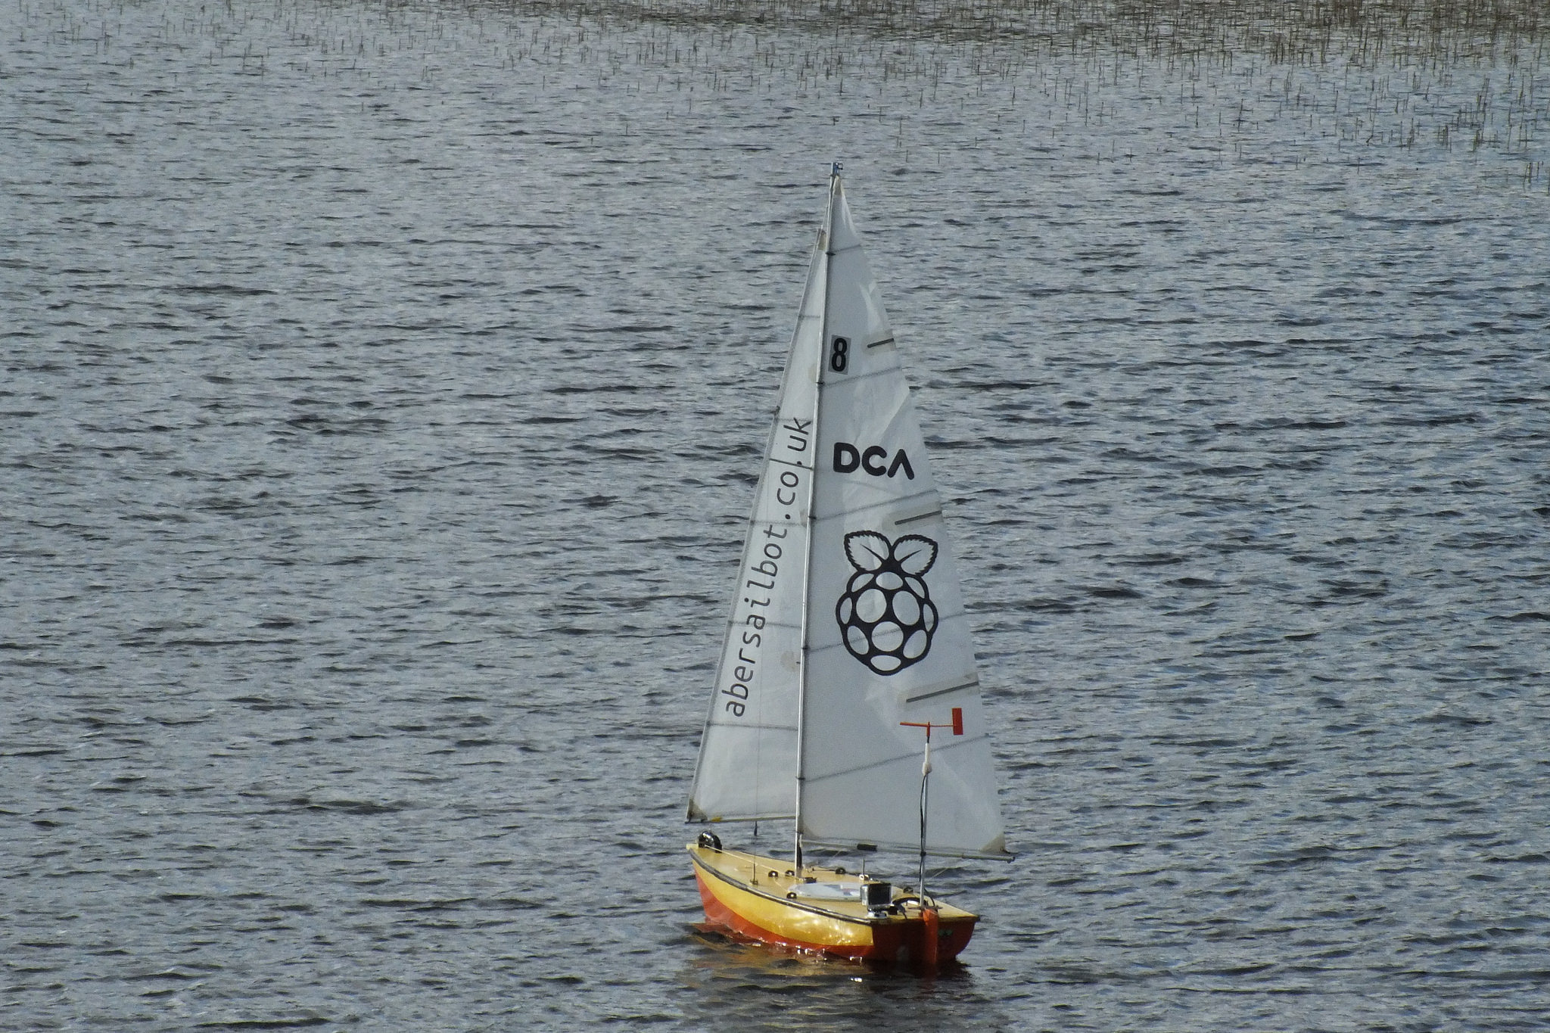
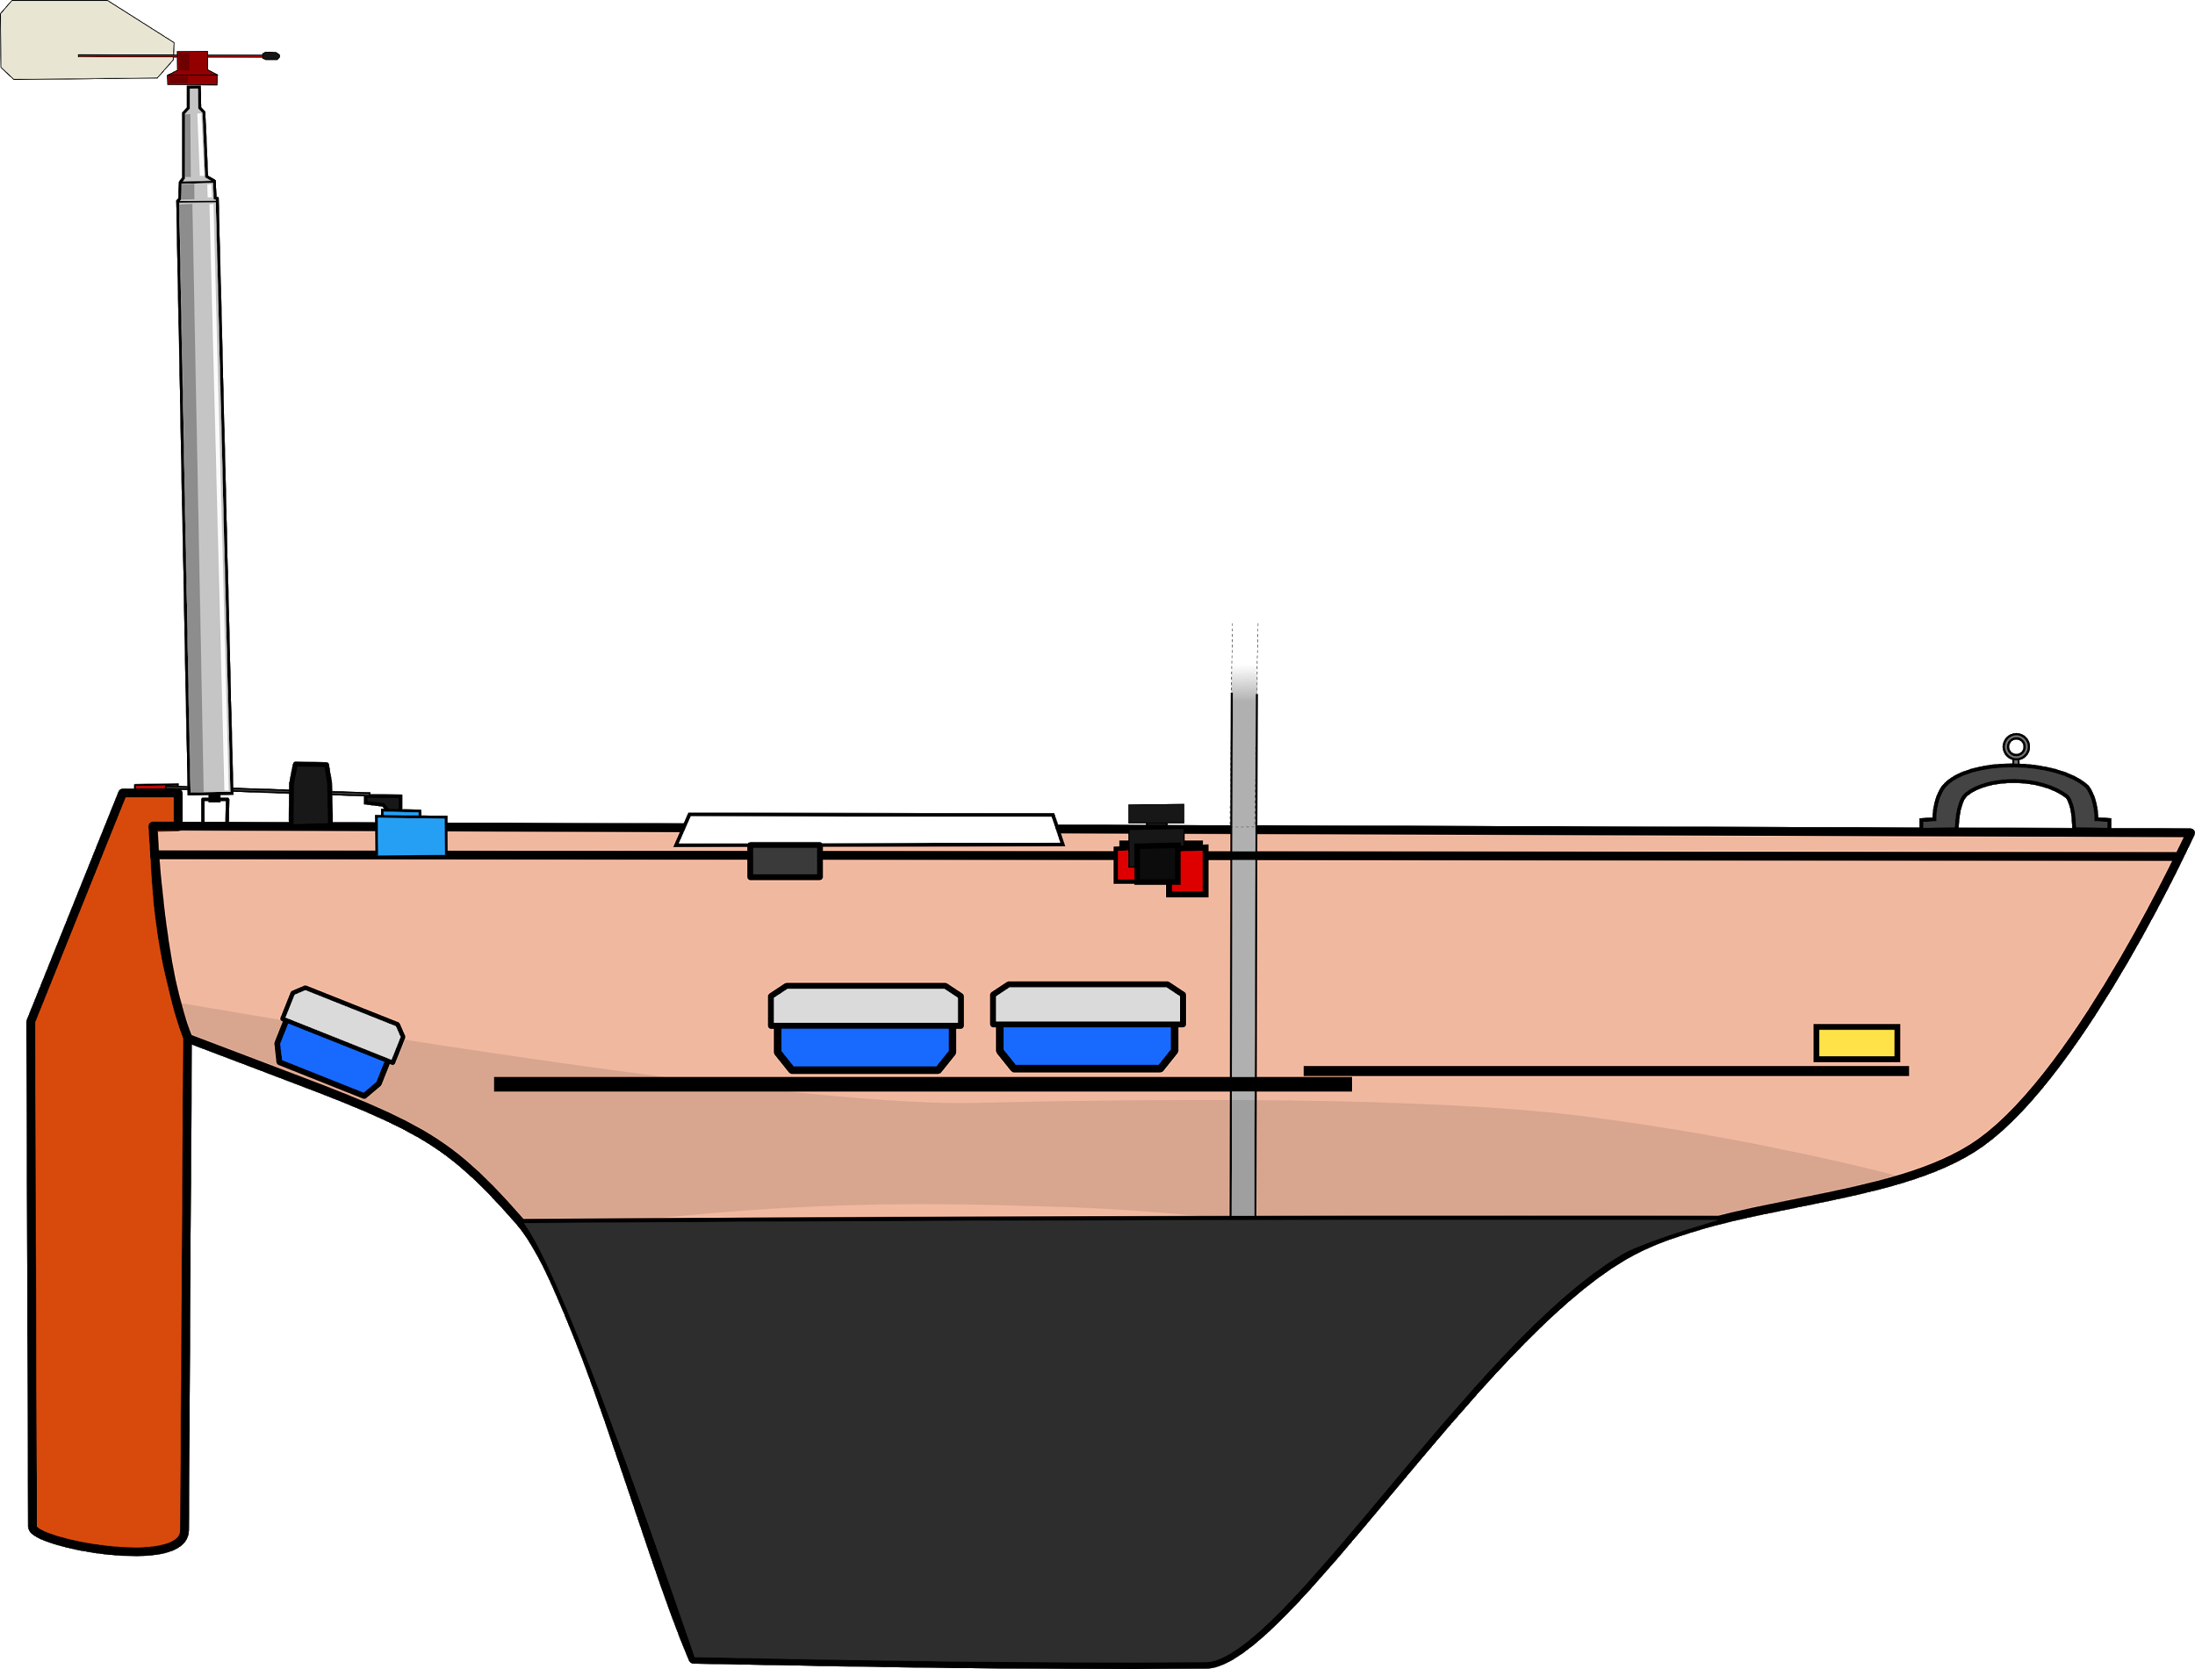
The Boats
Dewi’r Ddraig
Kitty
fb.com/abersailbot @abersailbot sailbot@aber.ac.uk
Notes:
Dewi’r Ddraig
Facts
Main and Jib
Maxi-MOOP hull - Paul Miller
1.2M, not the fastest, strong wind
Stable & reliable
New
Wind Sensor - dept design (rotary encoder)
Handle
Storm Sails
Electronics…
We have a simulator...
Kitty
Still work to be done
Needs new sail
Boat much larger
Detachable keel

Slide 8


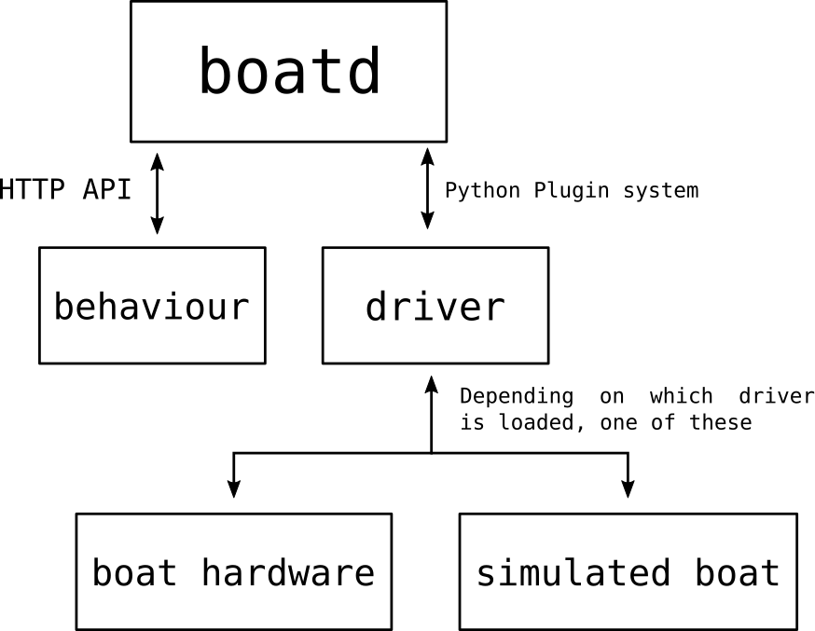
Software
Robotic Sailing Boat Daemon
Independent behaviours
Boat specific drivers
boatd
https://github.com/abersailbot
fb.com/abersailbot @abersailbot sailbot@aber.ac.uk
Notes:
---TOM---
Boat Daemon
Open Source
Run boat control behaviour (any language)
Talking to boat via driver
Functions: Great Circle

Slide 9
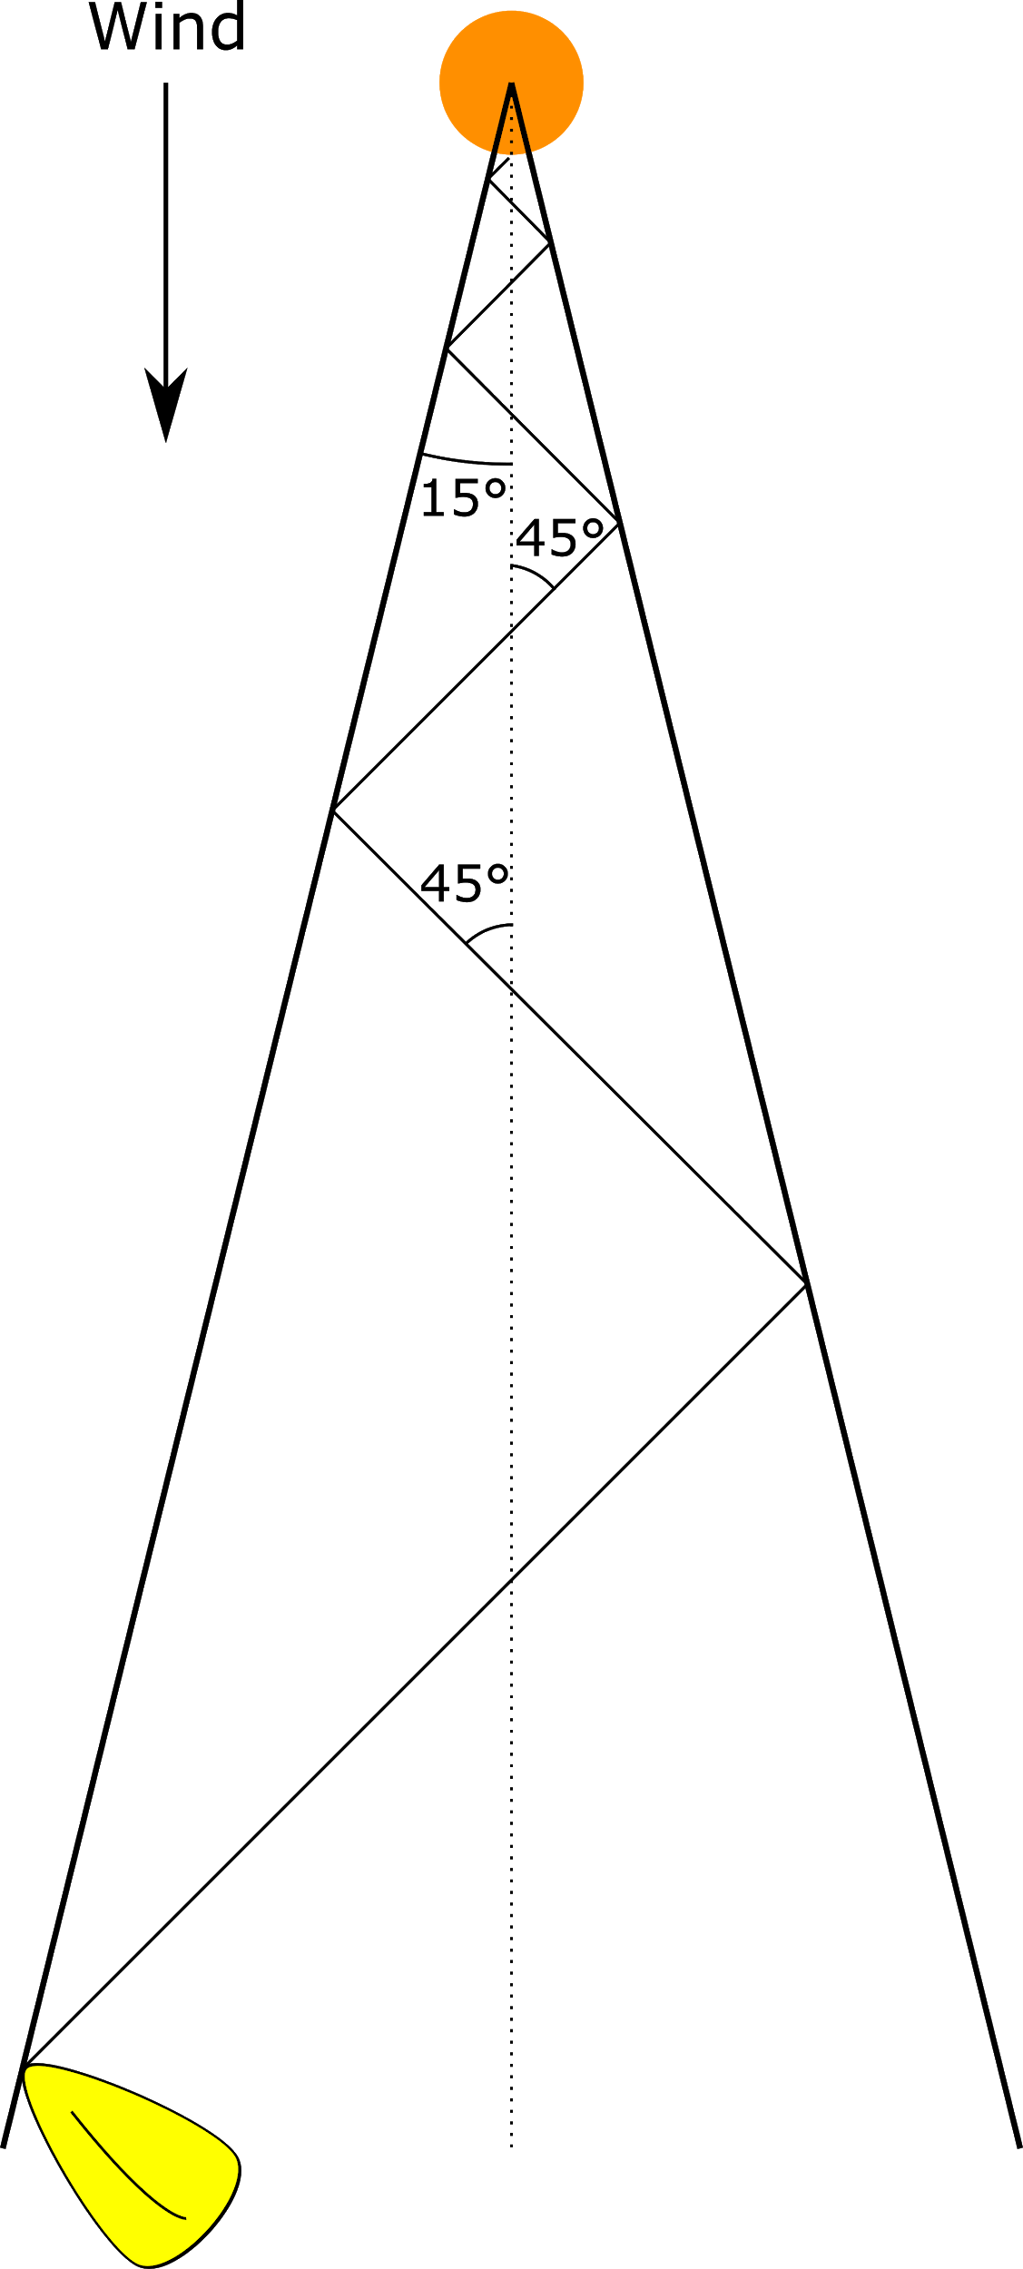
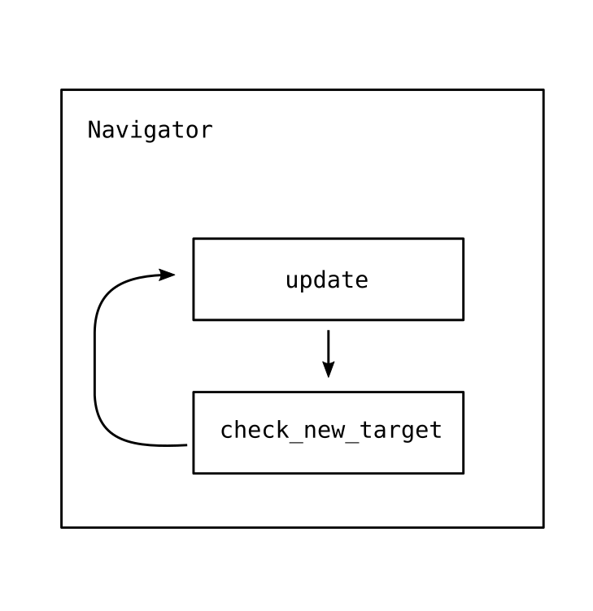
Behaviour
fb.com/abersailbot @abersailbot sailbot@aber.ac.uk
Notes:
Beating:
What it is
Why
Angle - wind from boat - check if >15*
Sail 45* to wind
Navigator
Speak to boatd
Load behaviour - station keep etc.

Slide 10
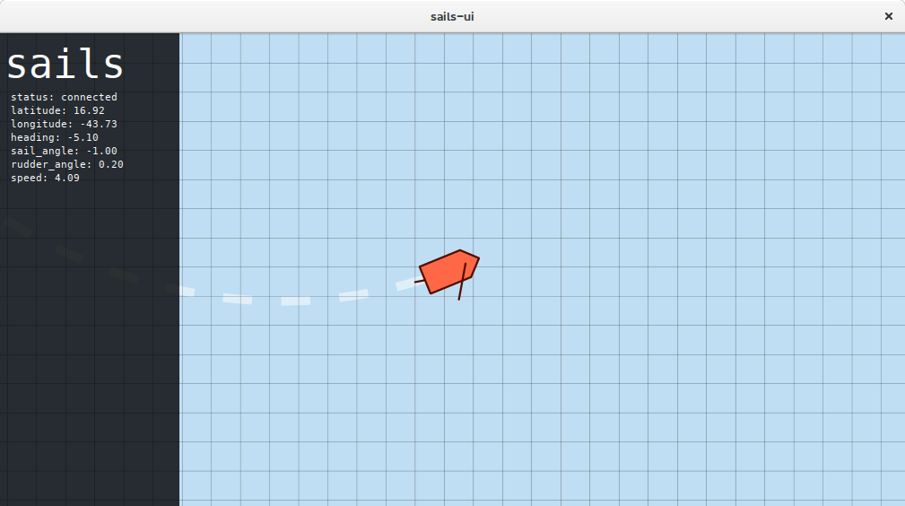
Simulation
https://github.com/sails-simulator
fb.com/abersailbot @abersailbot sailbot@aber.ac.uk
Notes:
sailsd
Louis Taylor - now left
Written in C
Simulates sailing physics
Run with boatd
JSON over TCP Socket

Slide 11
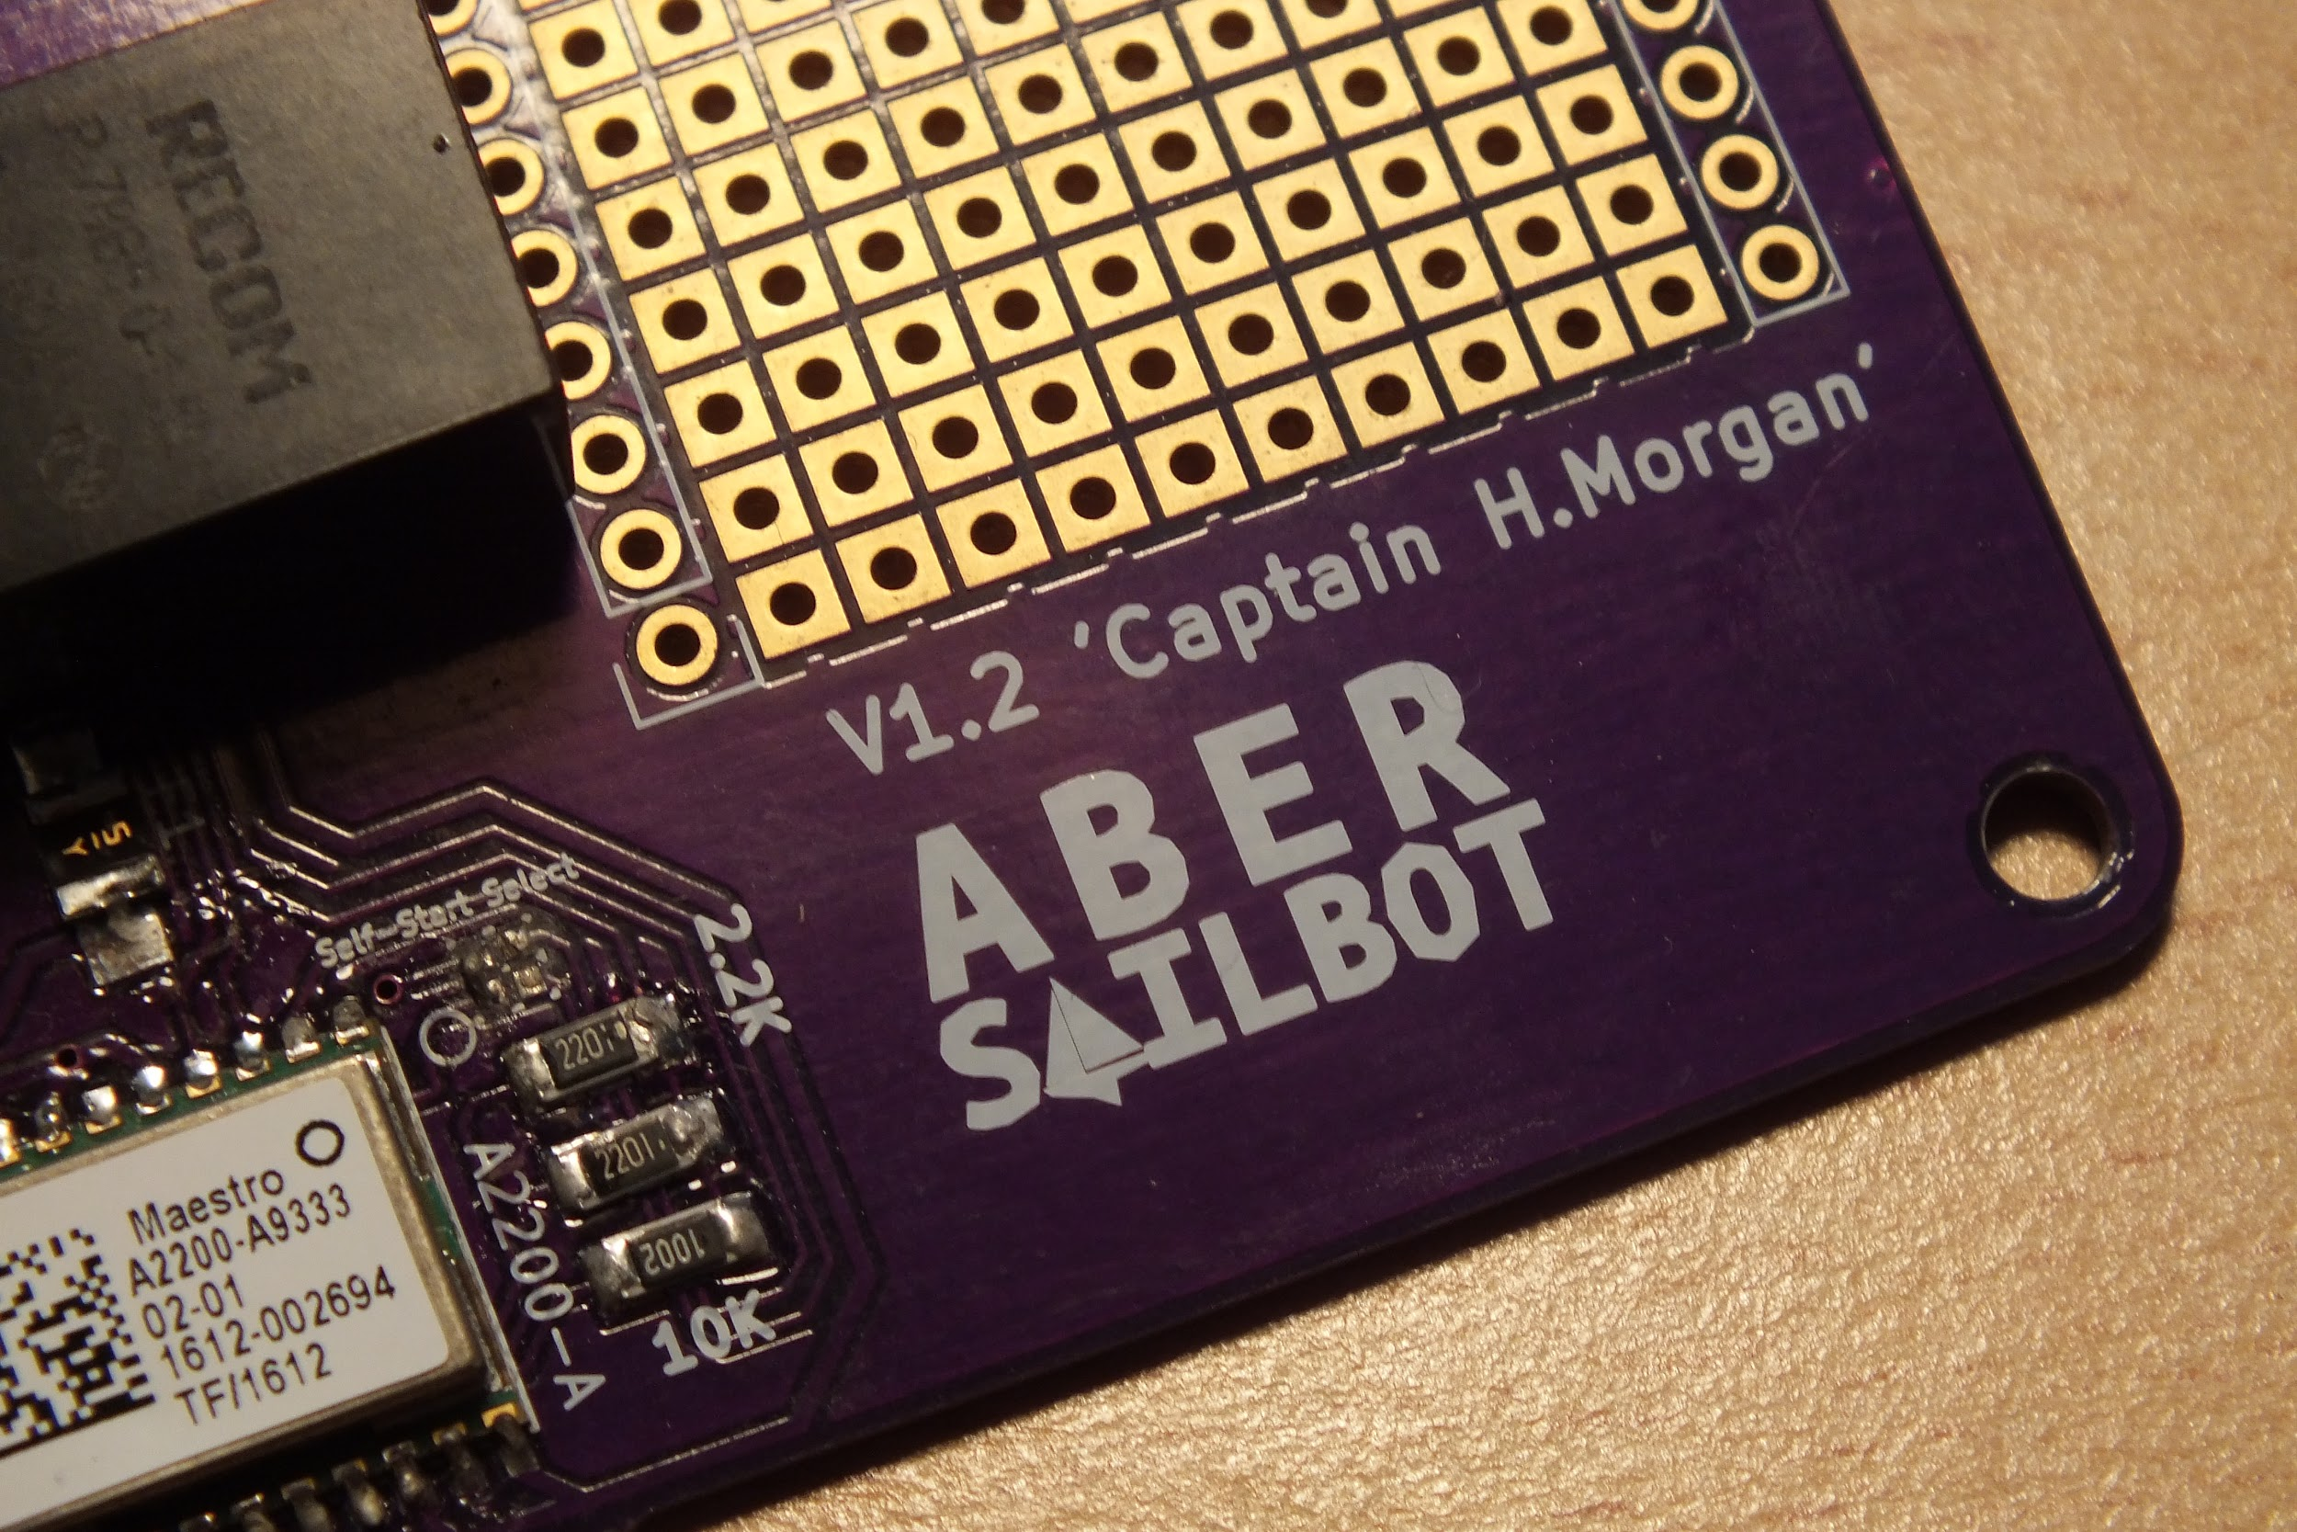
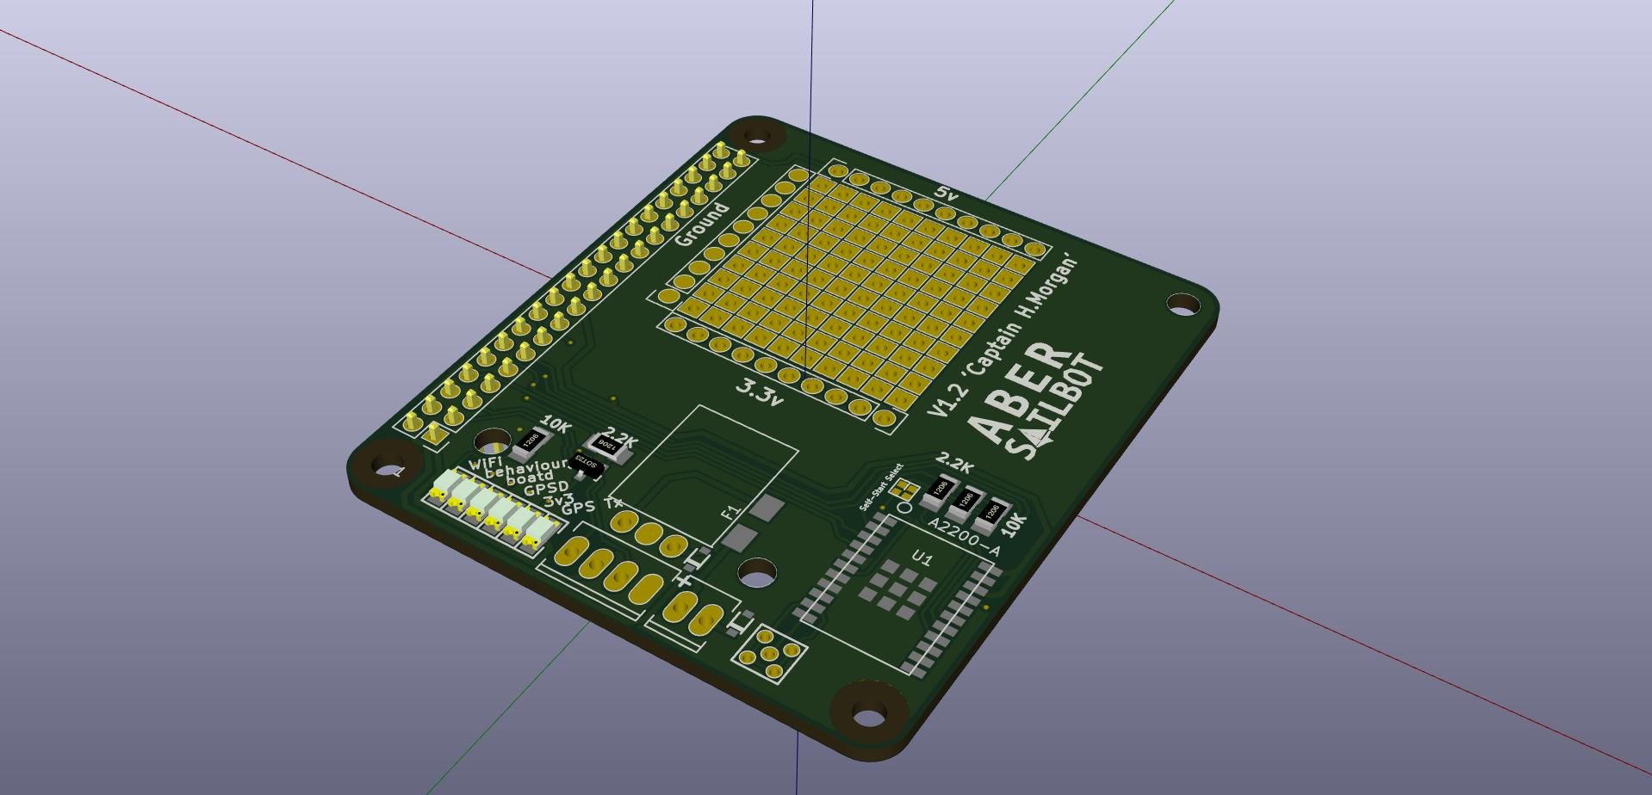
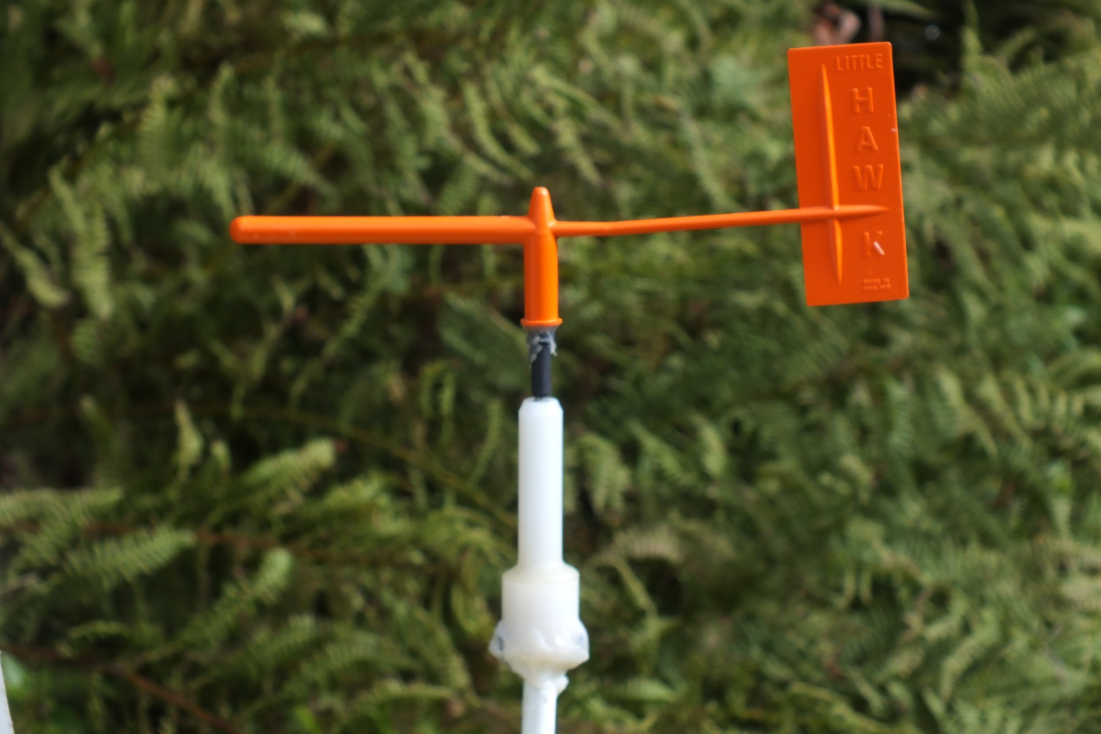
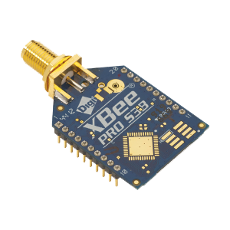
Electronics
RaspberryPi and Arduino
Captain Morgan PCB
Wind Sensor
Compass
fb.com/abersailbot @abersailbot sailbot@aber.ac.uk
Notes:
RaspberryPi
Python
WiFi Access
Arduino
More maintainable and reliable, tidy
PCB - Captain H. Morgan
Wind Sensor - Designed by dept
Was Messy

Slide 12
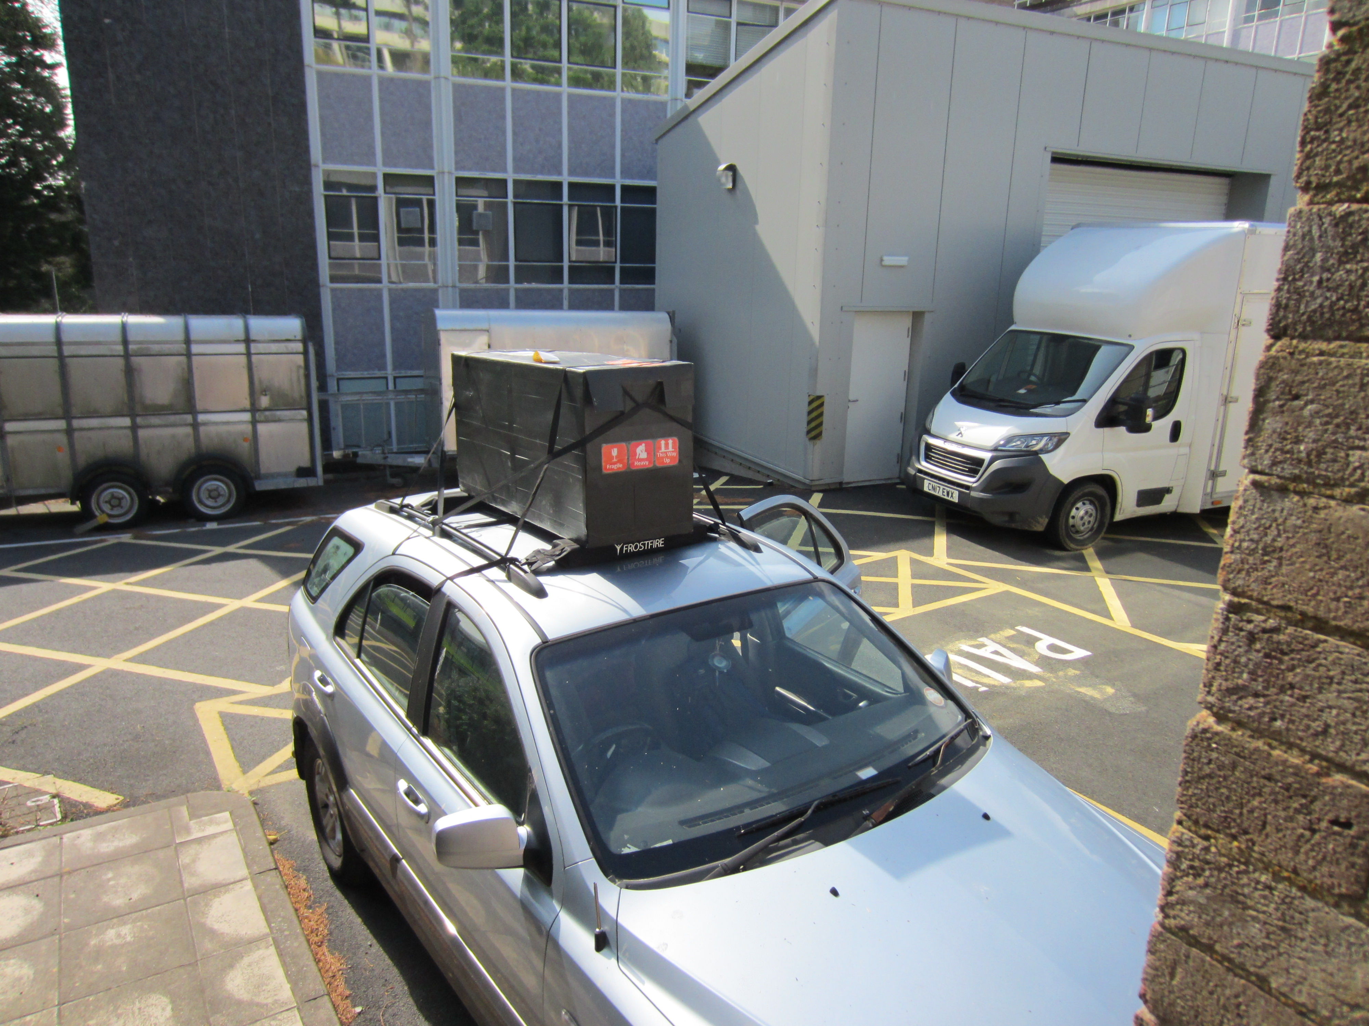
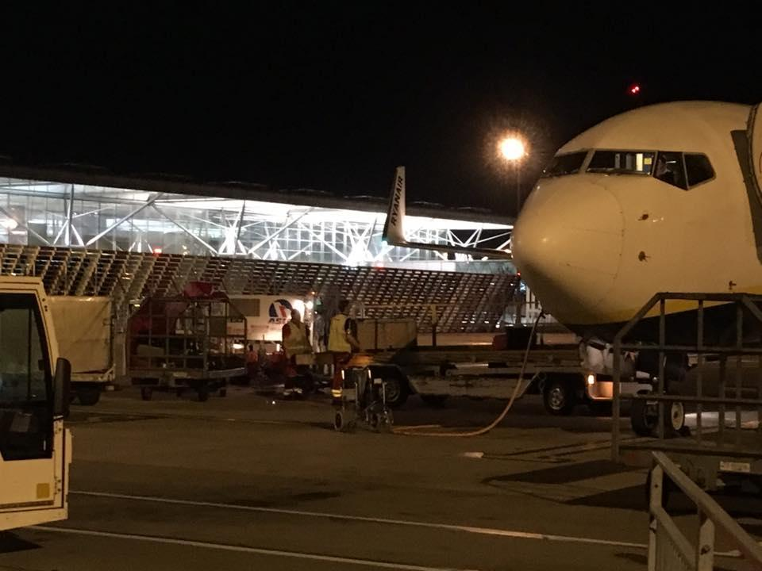
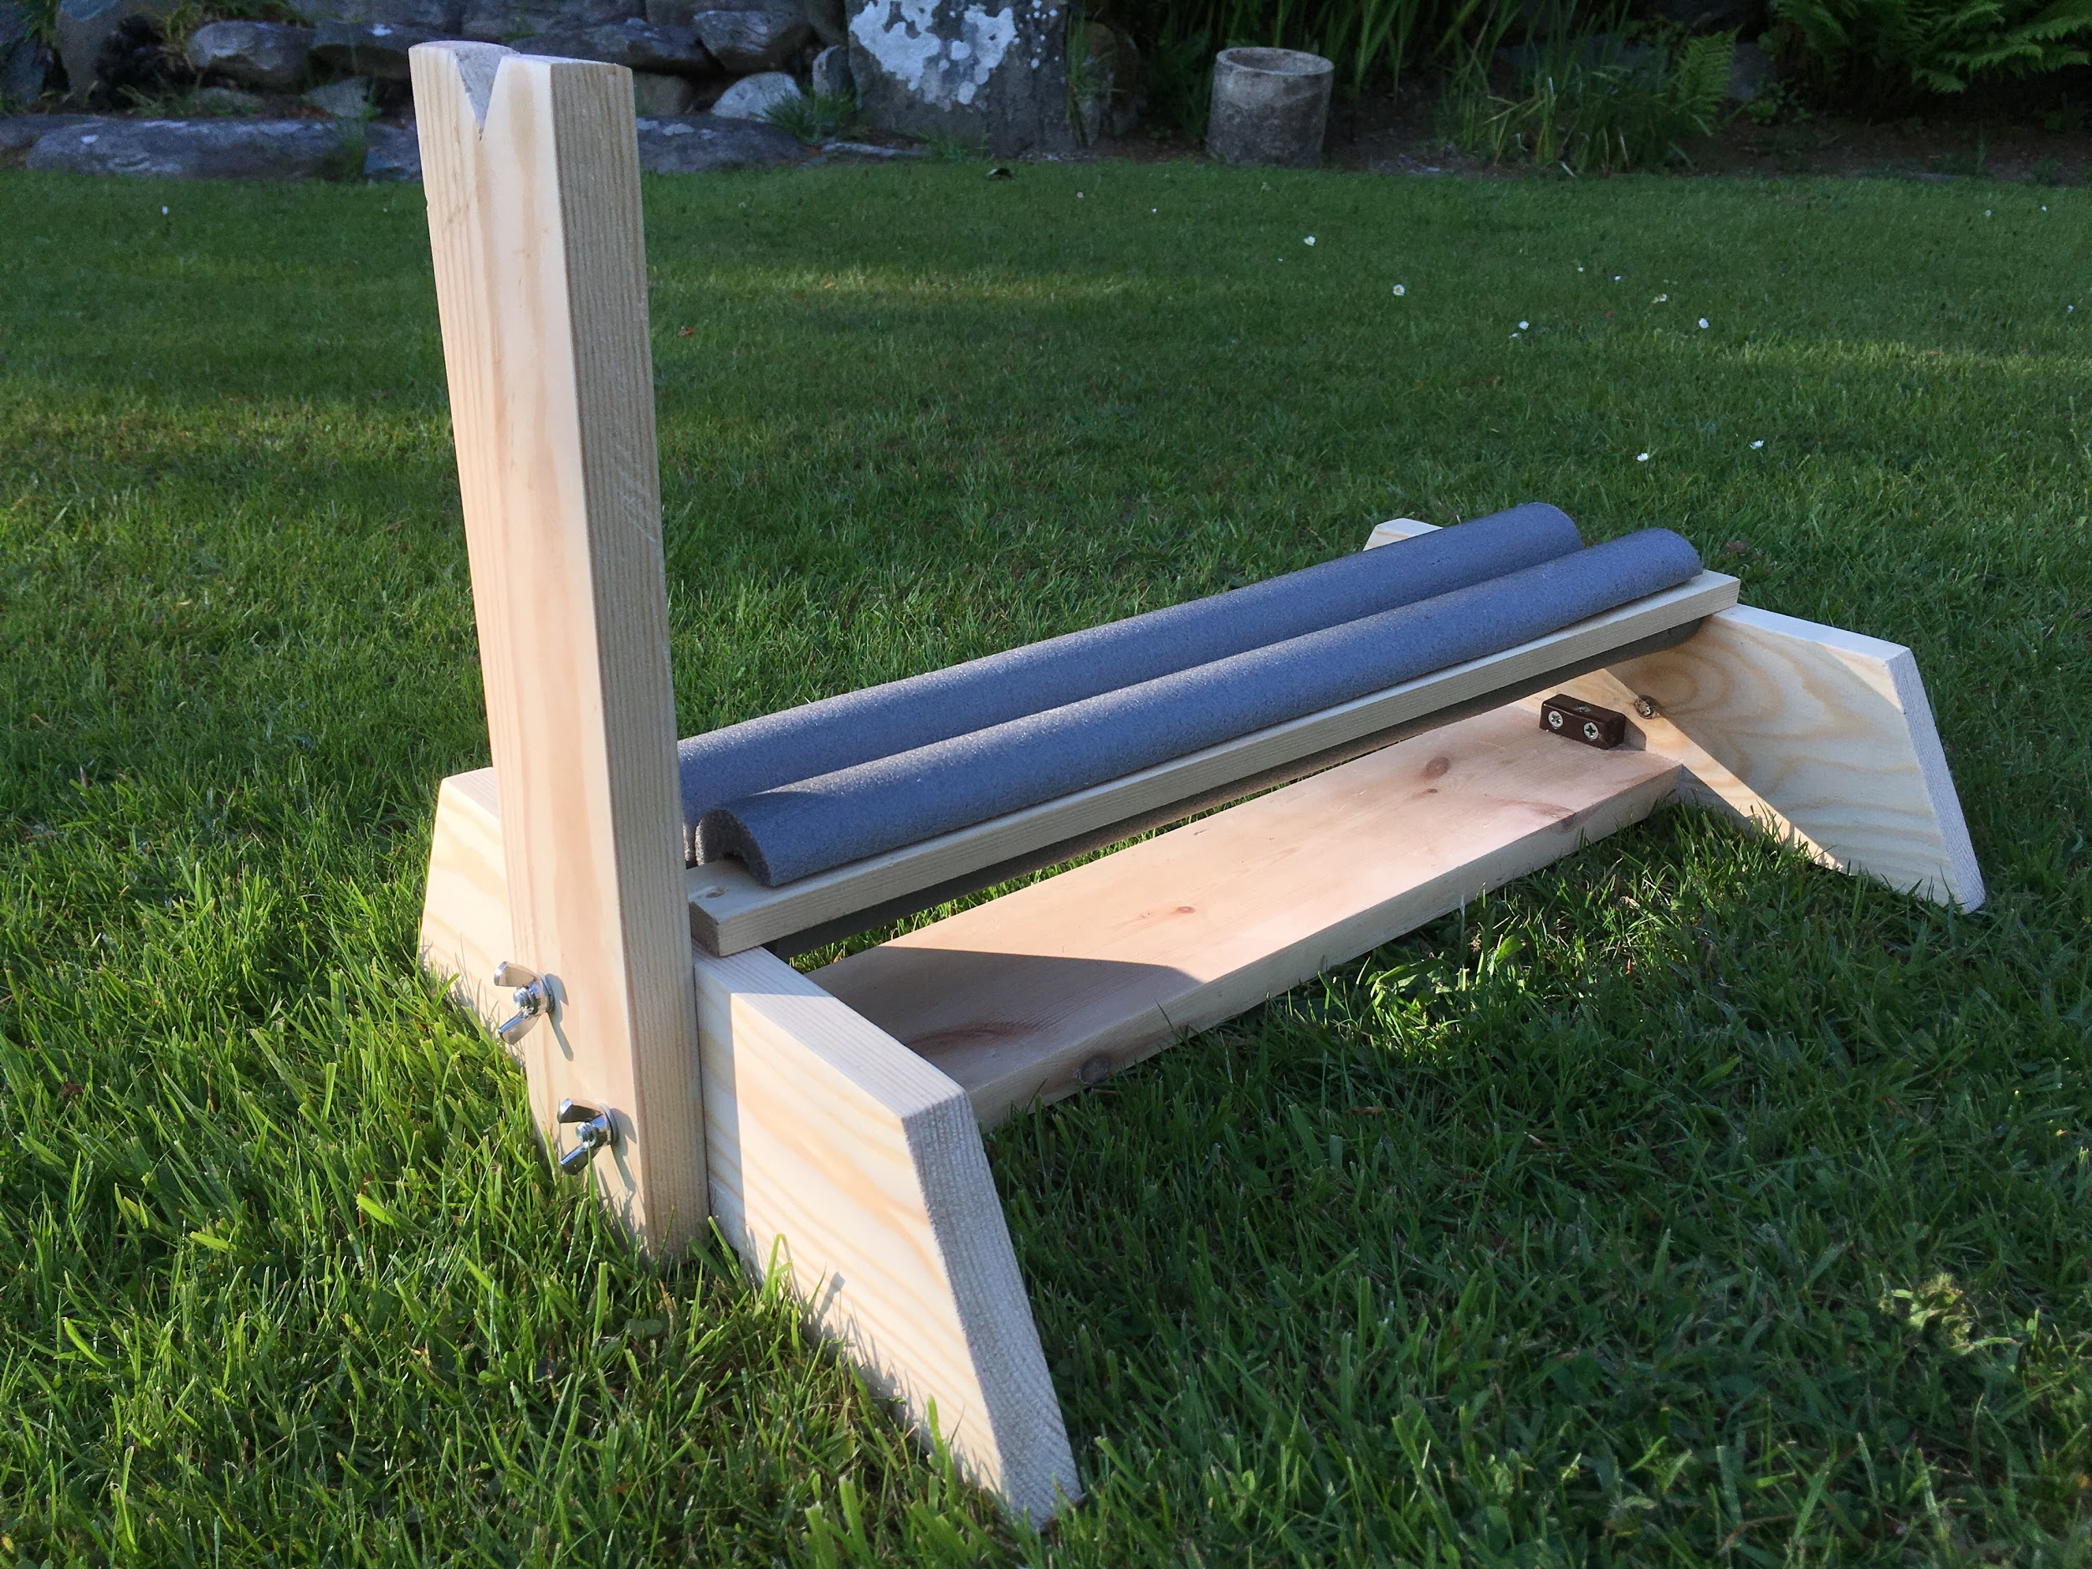
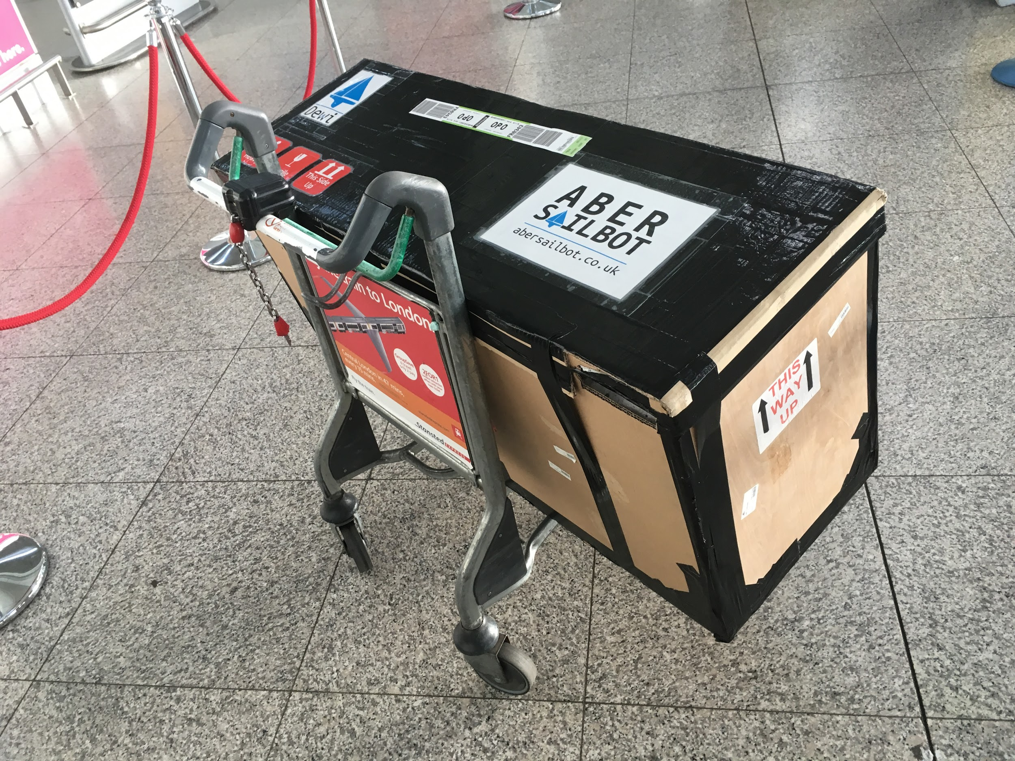
Transport
fb.com/abersailbot @abersailbot sailbot@aber.ac.uk
Notes:
Old Box & New Replacement
Transporting to Canada
Replacement stand

Slide 13

Competitions - Sailbot
SailBot
Student focused
Emphasis on boat design
Usually in USA or Canada
June 2022 (TBC)
Amesbury, (near Boston)
Massachusetts, USA
fb.com/abersailbot @abersailbot sailbot@aber.ac.uk
Notes:
International Robotic Sailing Regatta (known as Sailbot)
Annual - North America
University teams
RC and Autonomous

Slide 14

Competitions - WRSC
World Robotic Sailing Championships
More research focused
Emphasis on autonomy
Collision Avoidance
Station Keeping
Area scanning
No plans for 2022 yet
We were going to co-host 2020
fb.com/abersailbot @abersailbot sailbot@aber.ac.uk
Notes:
International Robotic Sailing Regatta (known as Sailbot)
Annual - North America
University teams
RC and Autonomous

Slide 15
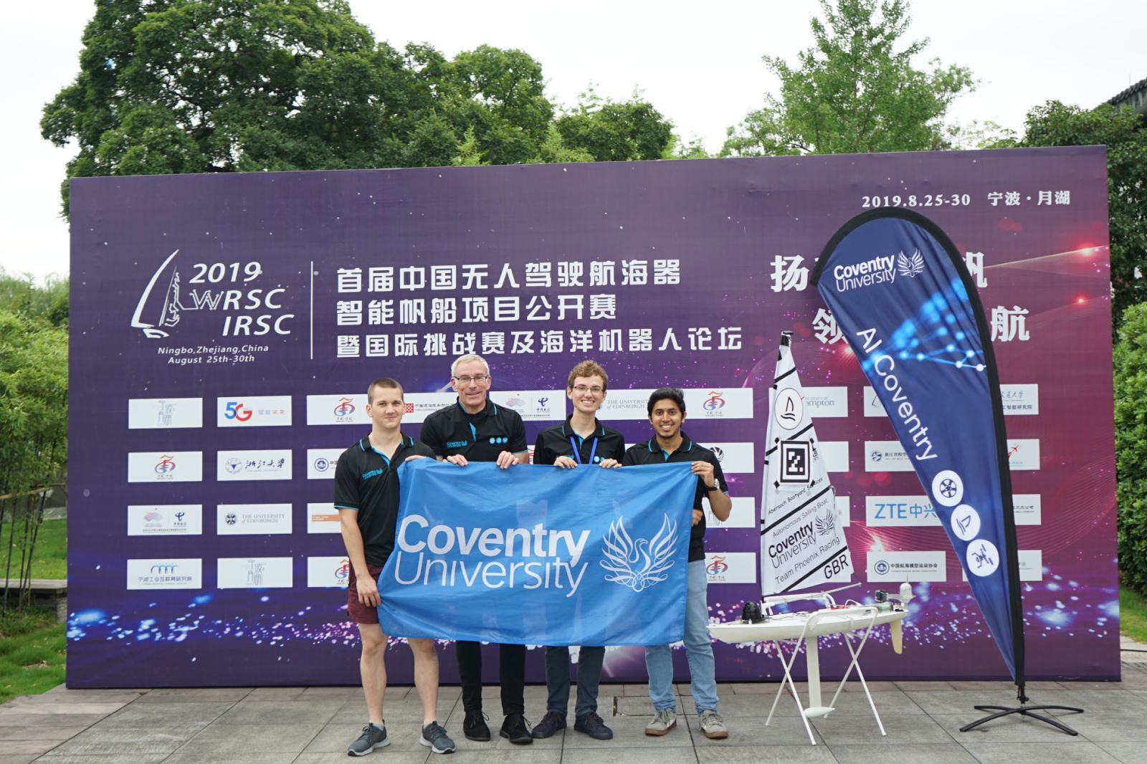
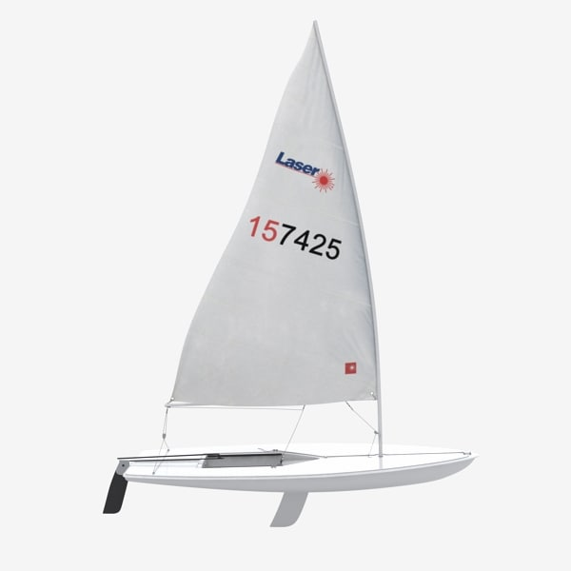
Competitions - Robosail
RC Laser Hulls
Everyone uses same boat
Joint Coventry-Aber event in the Easter Holidays.
April 19th-24th
fb.com/abersailbot @abersailbot sailbot@aber.ac.uk
Notes:
International Robotic Sailing Regatta (known as Sailbot)
Annual - North America
University teams
RC and Autonomous

Slide 16
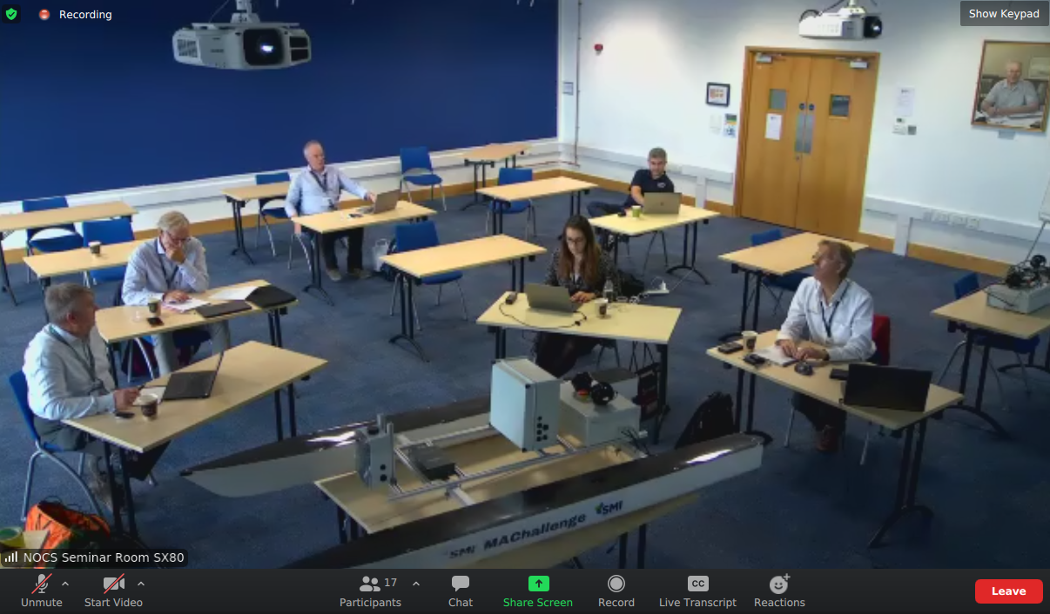
Competitions – Marine Autonomy Challenge
Motorboat Competition
Sponsored by industry
Open to UK Universities
Locate “litter” in the water
Remote access to the boat
Taking place in November, team already in place.
fb.com/abersailbot @abersailbot sailbot@aber.ac.uk
Notes:
International Robotic Sailing Regatta (known as Sailbot)
Annual - North America
University teams
RC and Autonomous

Slide 17
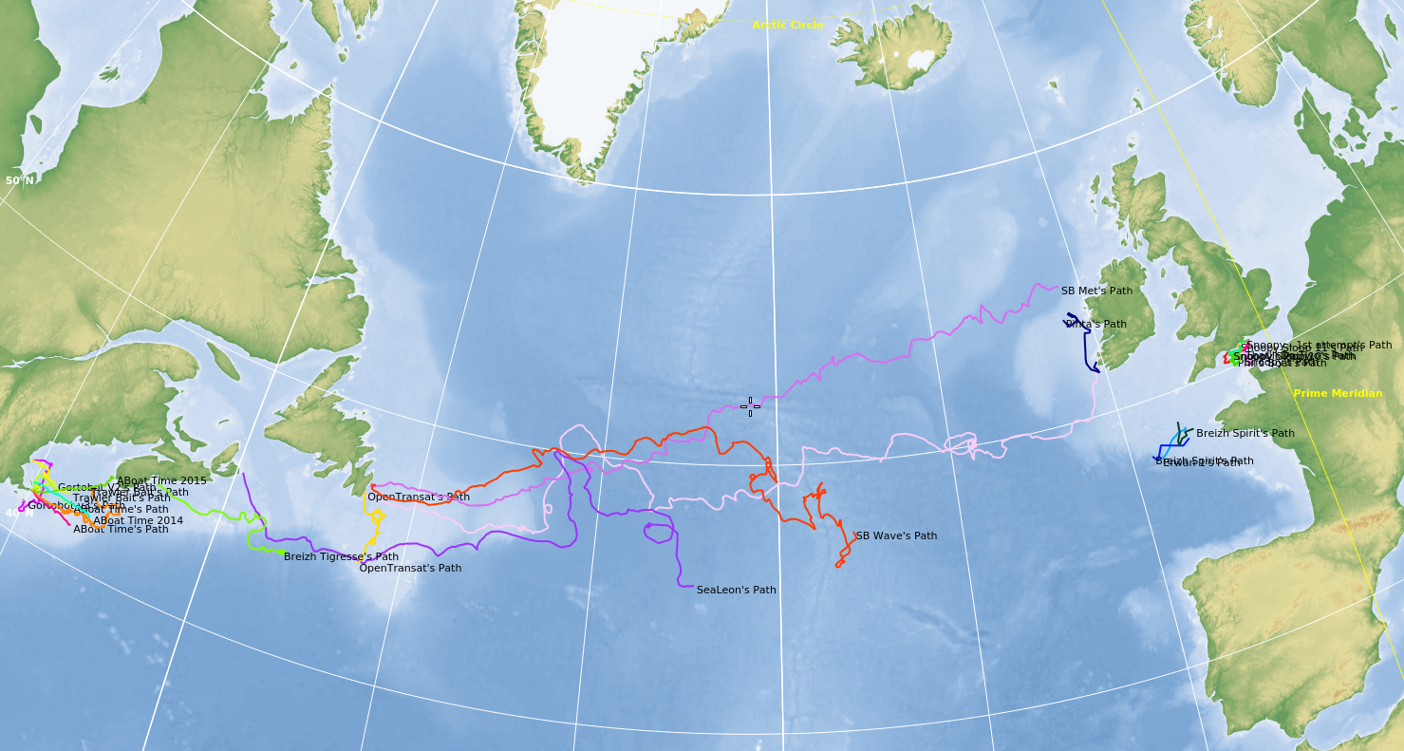
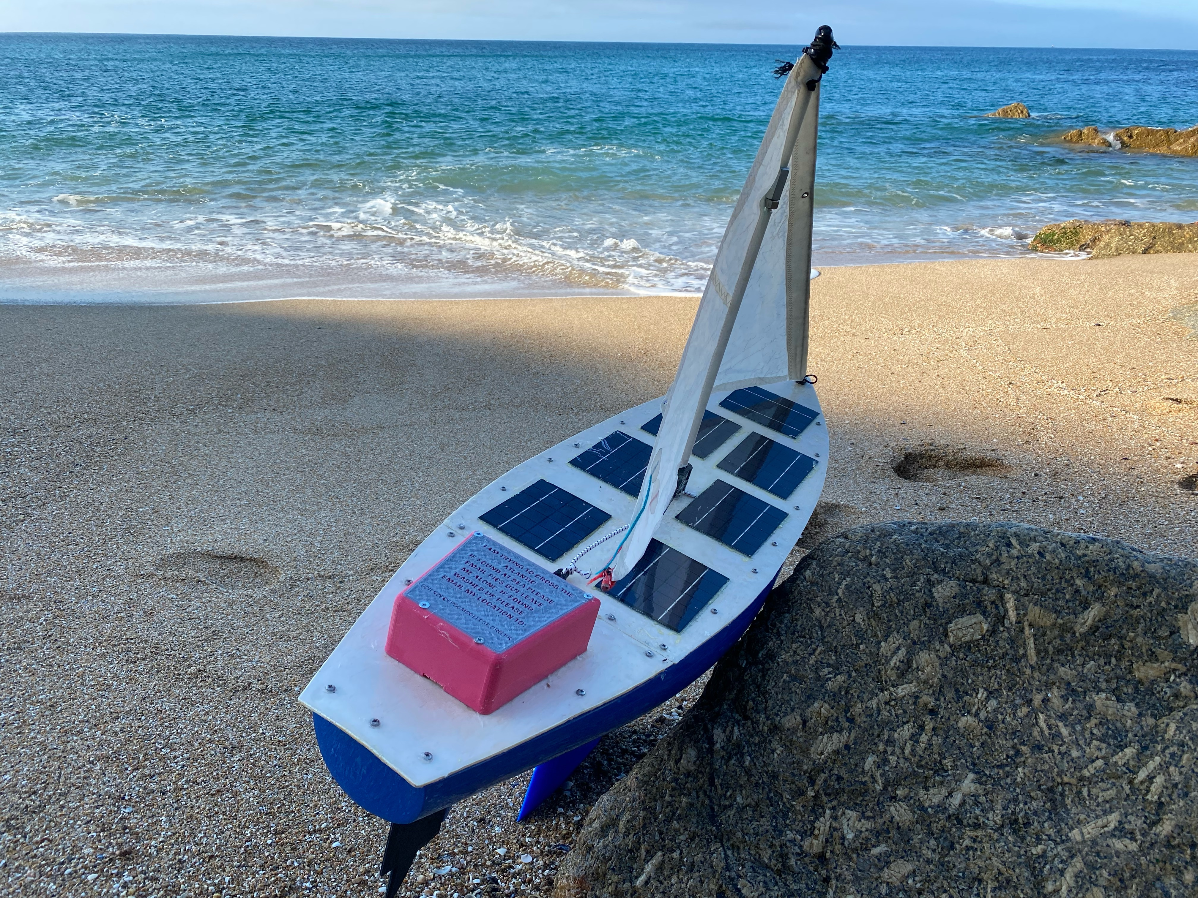
Competitions – Microtransat Challenge
Transatlantic Sailing Robot Race
Running since 2010
Over 30 attempts
1 success, 1 in progress
AberSailbot yet to compete
fb.com/abersailbot @abersailbot sailbot@aber.ac.uk
Notes:
International Robotic Sailing Regatta (known as Sailbot)
Annual - North America
University teams
RC and Autonomous

Slide 18
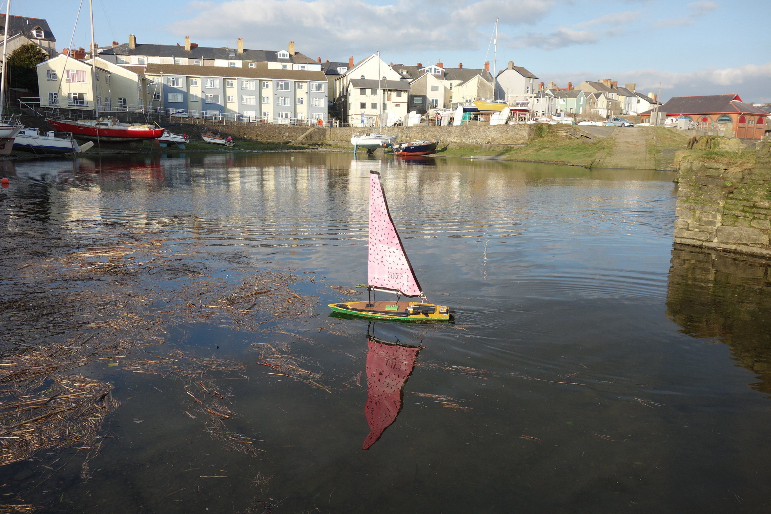
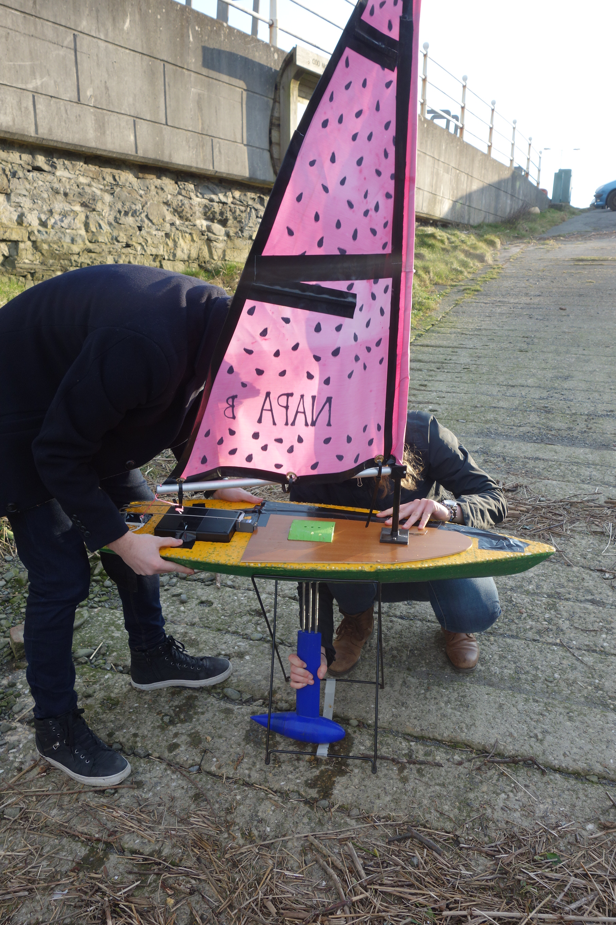
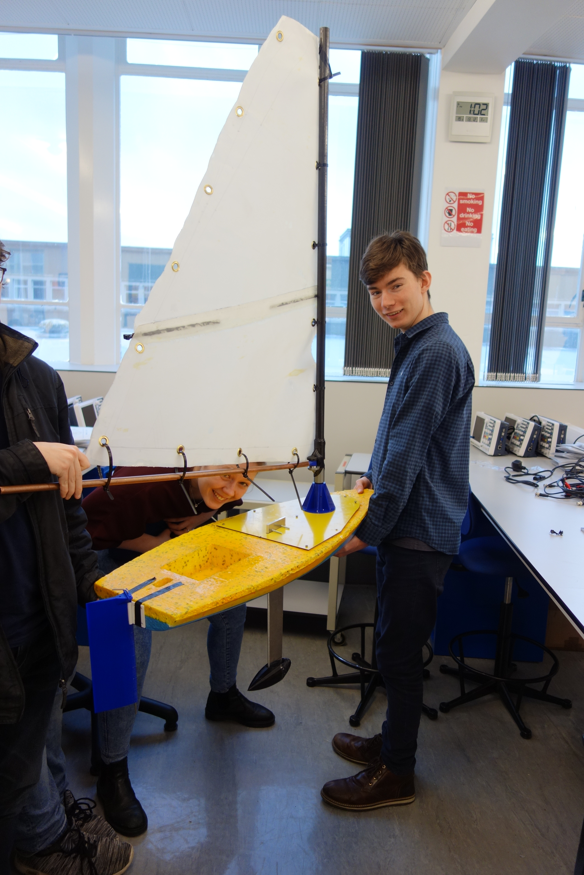
Mini Polystyrene Boat competition
3 Boats
Teams of 4 or 5 people
Polystyrene RC laser hull
Raspberry Pi computer
Standard AberSailbot software
Race November 20th/21st
fb.com/abersailbot @abersailbot sailbot@aber.ac.uk
Notes:
Robotic Boats
RC and Sail Themselves
Code (boatd etc)
Competitions
Microtransat
Not alone - community of people

Slide 19
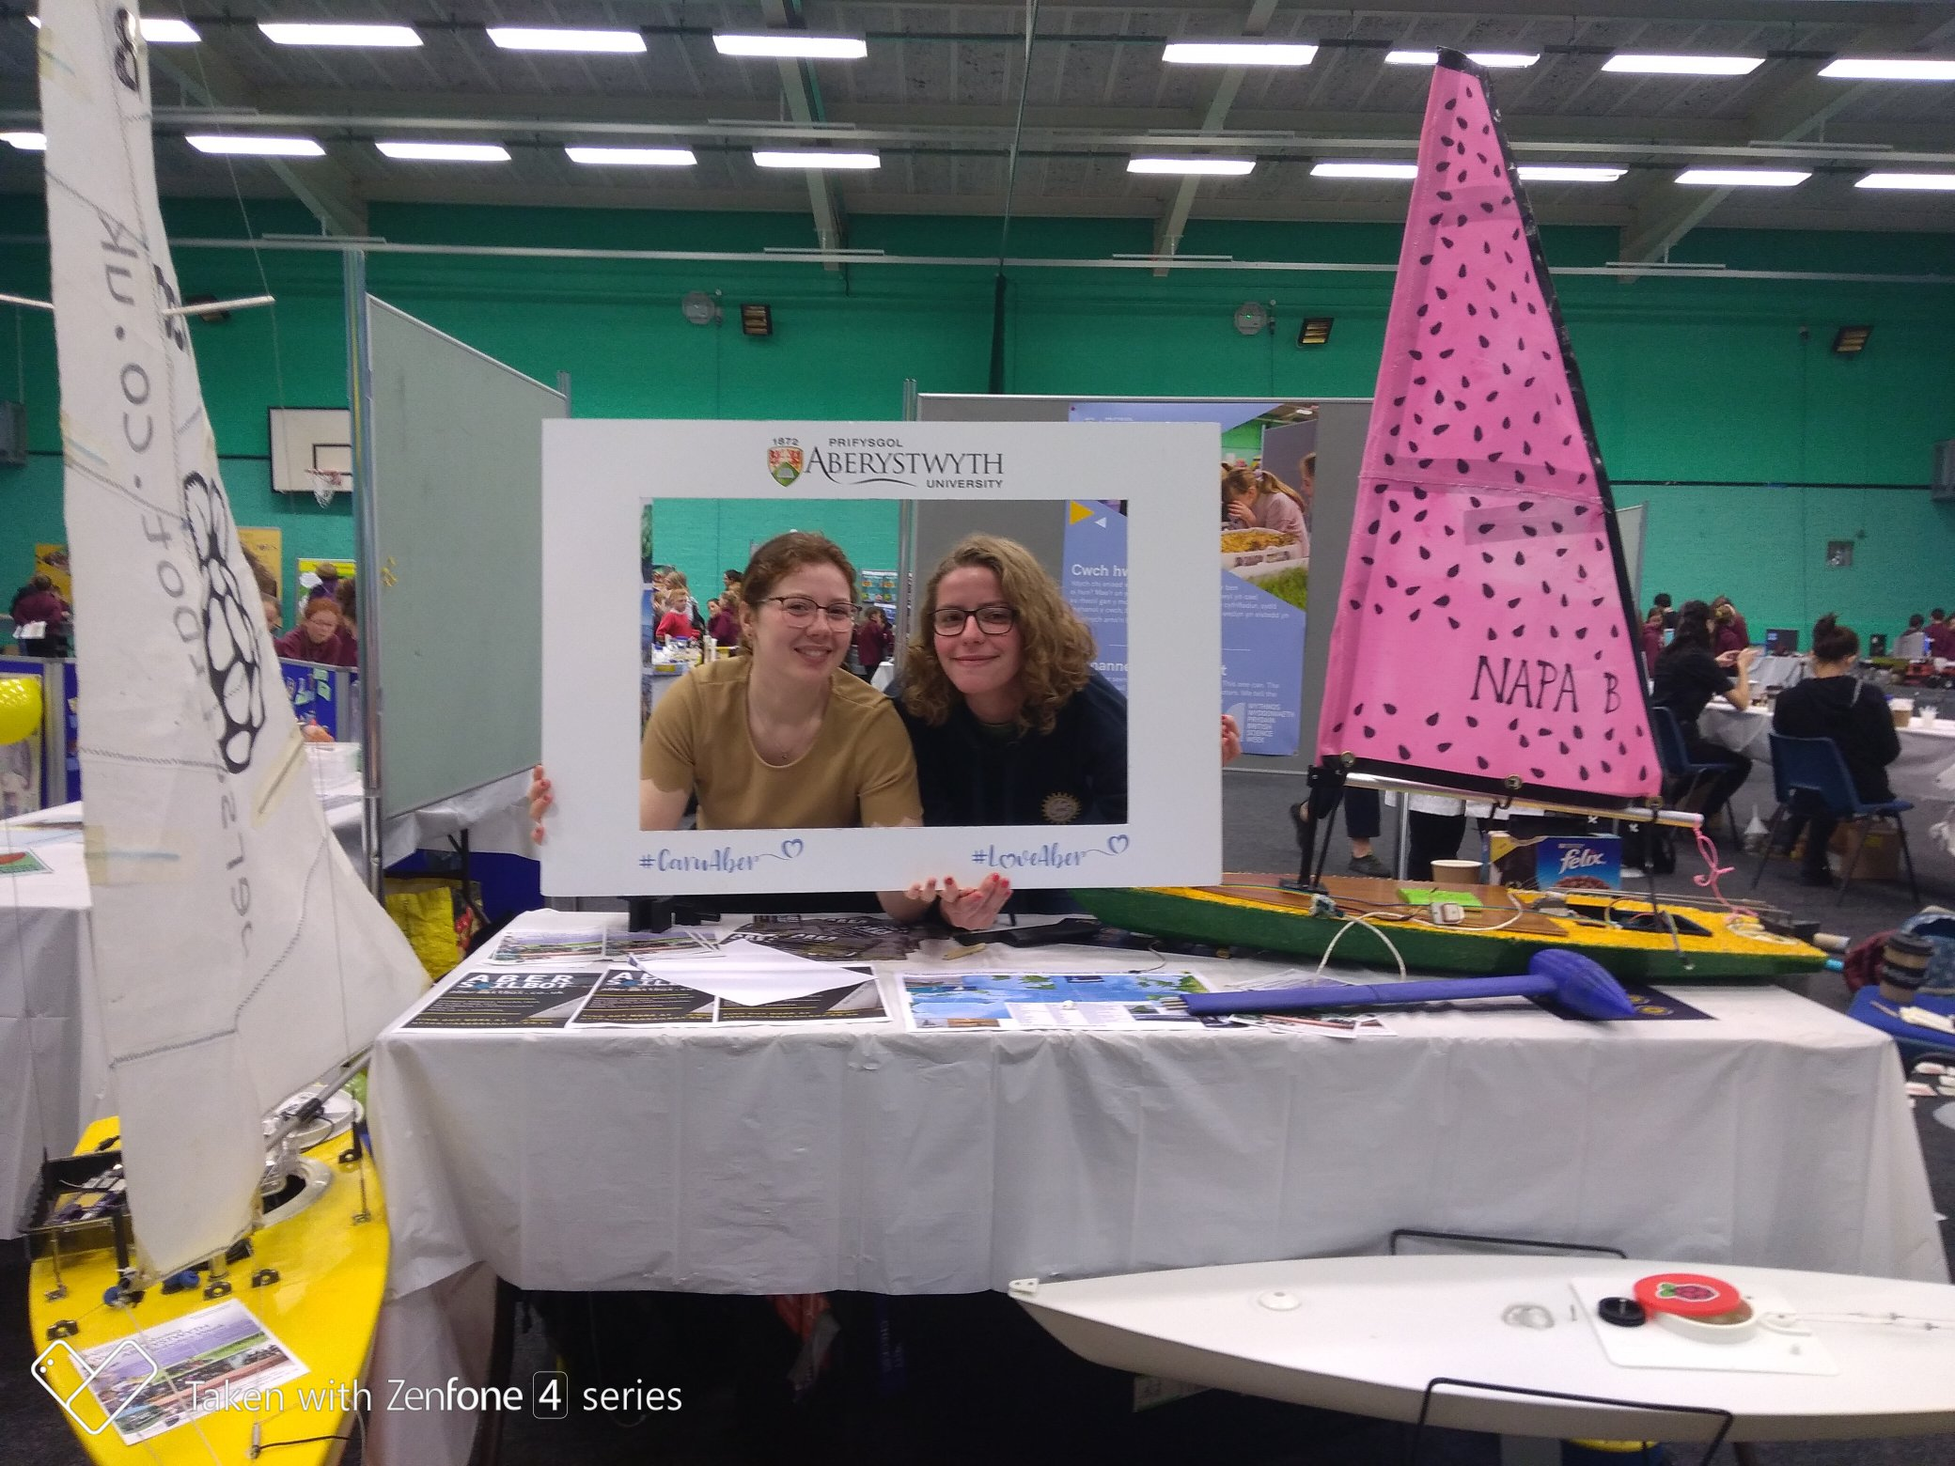
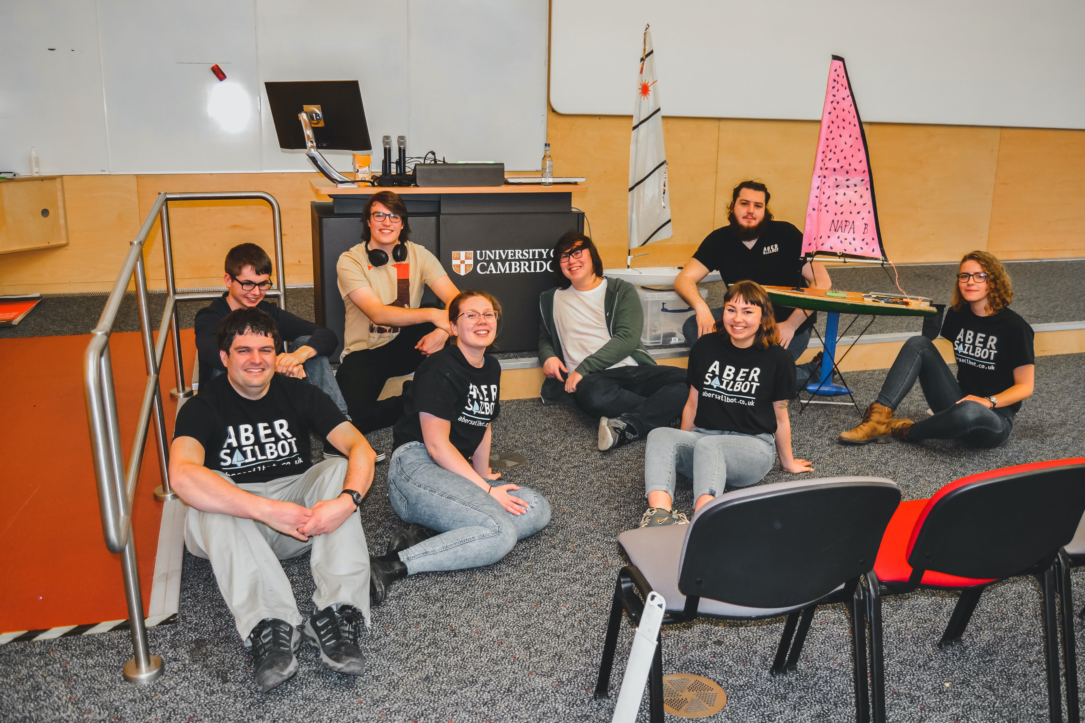
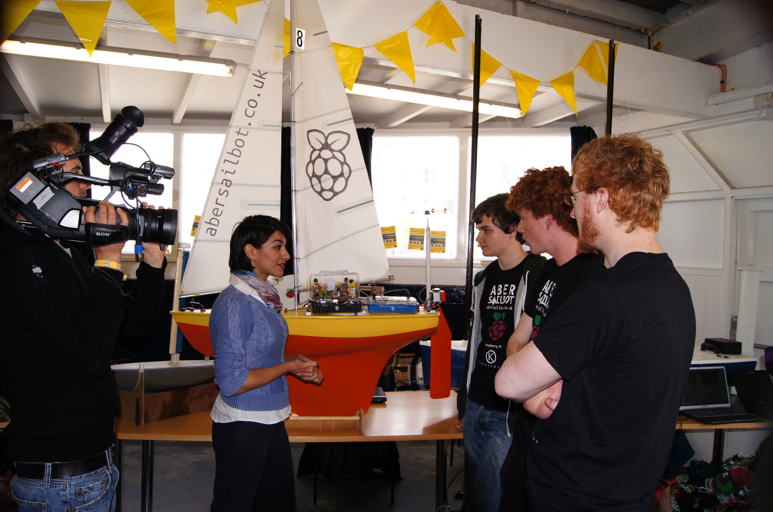
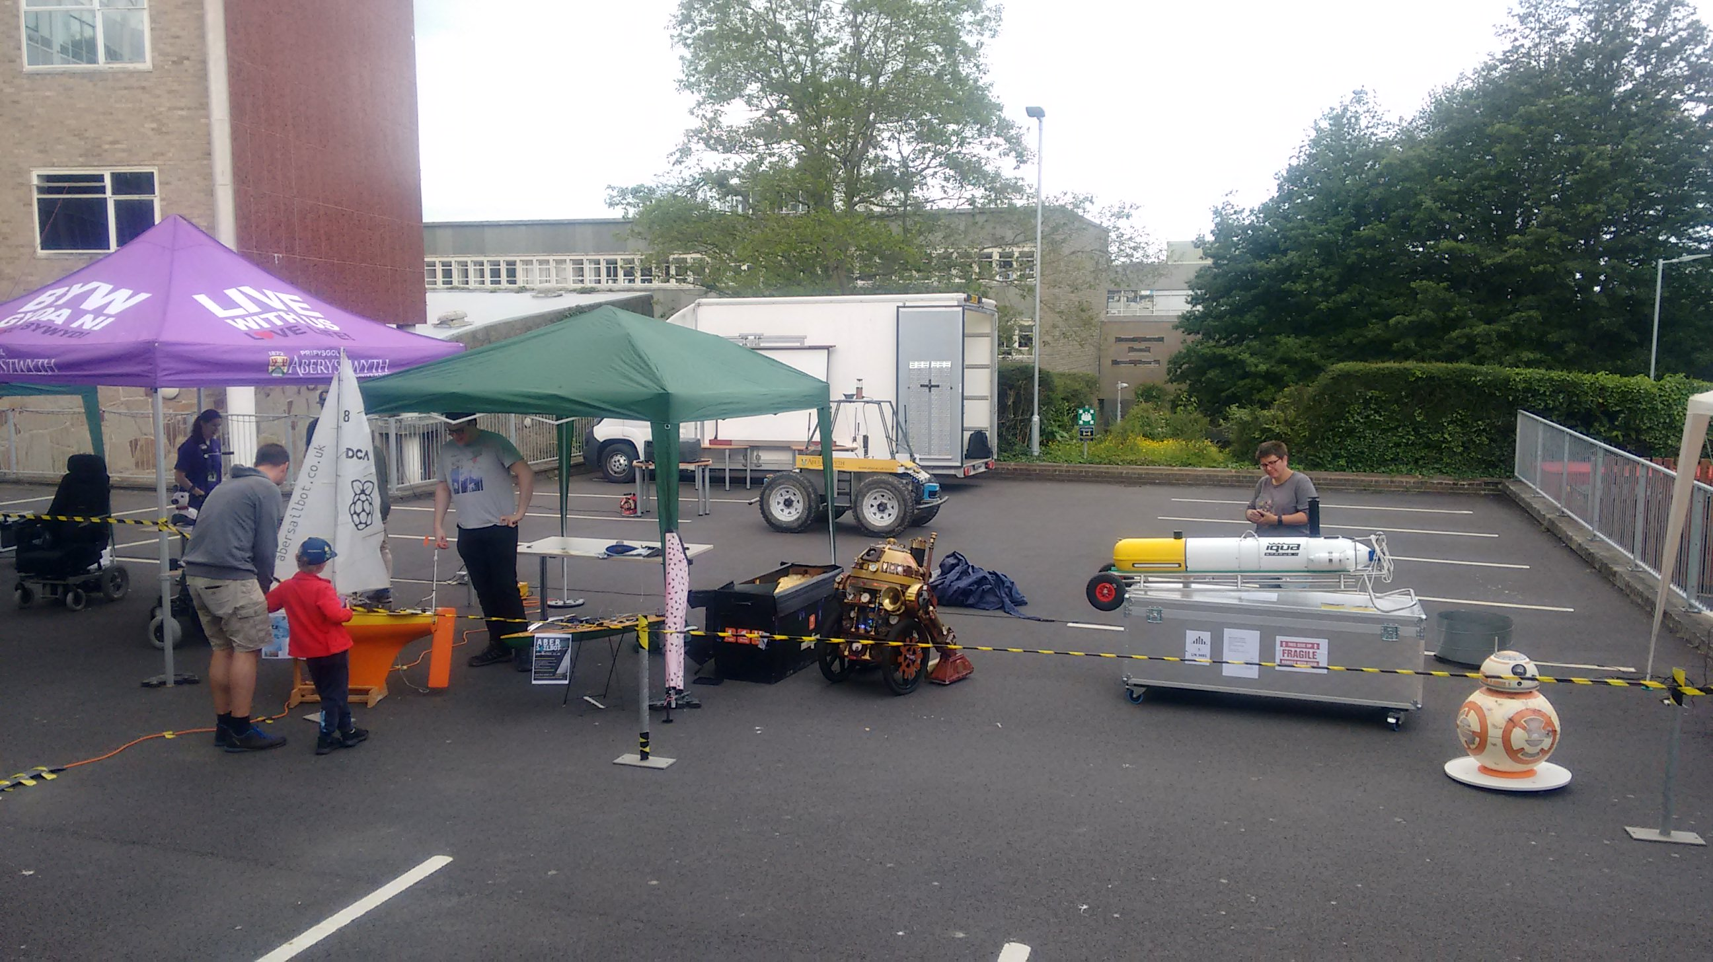
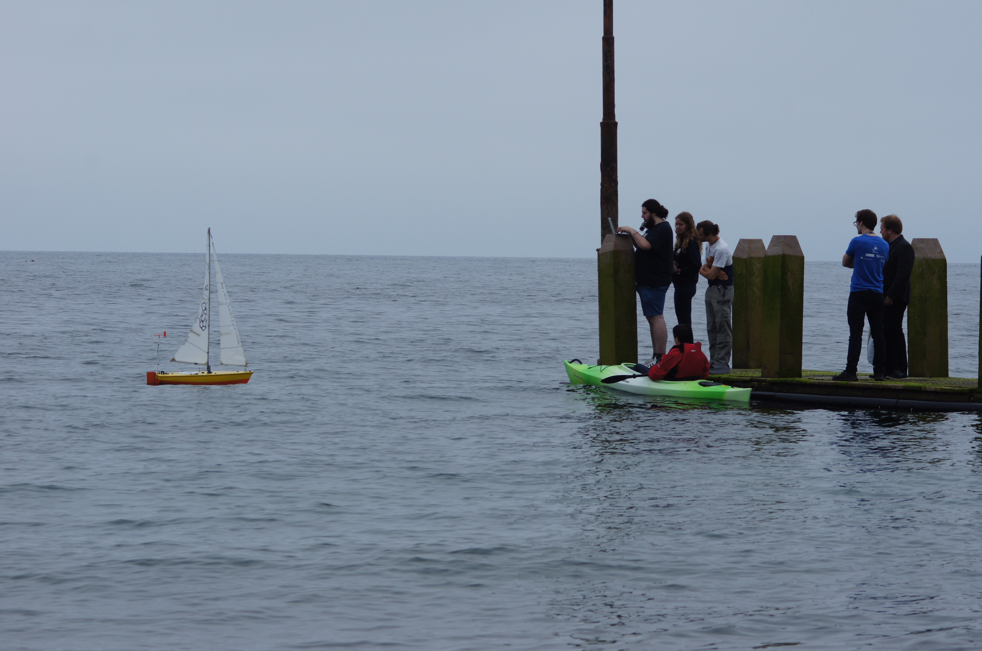
Public Engagement
Raspberry Jam
British Science Week
Beachlab
Open days
fb.com/abersailbot @abersailbot sailbot@aber.ac.uk
Notes:
International Robotic Sailing Regatta (known as Sailbot)
Annual - North America
University teams
RC and Autonomous

Slide 20
Plan for this year
Polystyrene boat competition – Mid November
Weekly theoretical/skills sessions
Robotise an RC Laser
New boat? Transatlantic?
Take Dewi to Sailbot
Science Week, Beachlab, Raspberry Jam
fb.com/abersailbot @abersailbot sailbot@aber.ac.uk
Notes:
Robotic Boats
RC and Sail Themselves
Code (boatd etc)
Competitions
Microtransat
Not alone - community of people

Slide 21
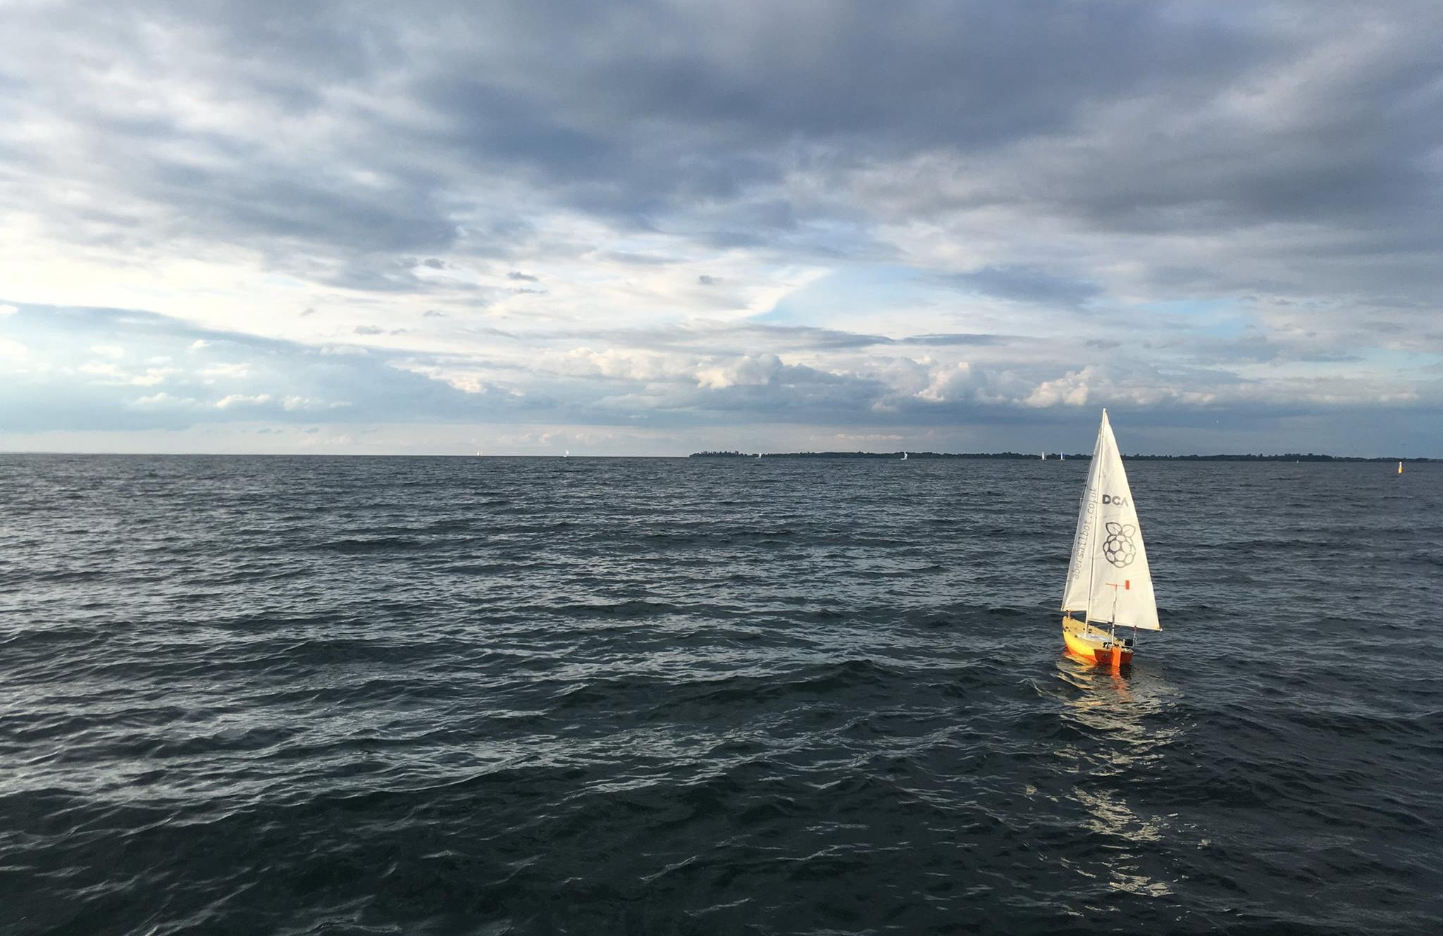
Any Questions?
Tell us when you’re available:
https://tinyurl.com/abersailbotskills
Join our mailing list https://abersailbot.co.uk/joinus
and Discord:
https://tinyurl.com/abersailbotdiscord
fb.com/abersailbot @abersailbot sailbot@aber.ac.uk
Notes:
Fill form (abersailbot.co.uk/joinus)
Give us email in ThinkTank
Facebook Message, Tweet, Email

